Slide 1
BALAJI TEMPLE MATRIMONIAL SERVICES REGISTERED ASPIRANTS GROOMS

Slide 2
2023
01B23
No Longer Available
02B23
No Longer Available
03B23
Hindu Naiyakar, Indian Citizen
D.O.B.: 06/12/1989
Qualification: MSc
Currently working as an Engineer
Hobbies: Trekking, Cycling, Yoga, Badminton, Climbing.
Looking for a well educated and family oriented bride.
04B23
Hindu, Indian Citizen
D.O.B.: 15/05/1997 Height: 5Feet 7’’
Qualification: MSc
Looking for a good bride with good family values.

Slide 3
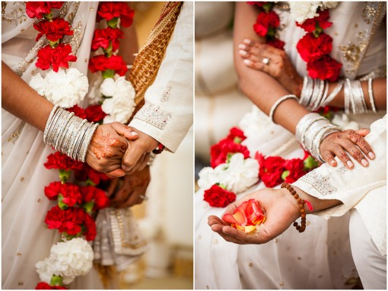
05B23
Hindu Reddy, Indian Citizen
D.O.B.: 21/03/1994 Height: 5Feet 11’’
Mother Tongue: Telugu
Qualification: Masters in Information Systems
Currently working as a Software Engineer (Support, Deployment, QA)
Hobbies: Gym, Cricket, Sleeping, Watching Movies.
Looking for Compatible, Understanding and Independent Women.
06B23
Hindu, British Citizen
D.O.B.: 20/06/1990 Height: 5Feet 5’’
Mother Tongue: English
Qualification: BSC/GDL
Currently working as a Corporate Solicitor
Hobbies: Outing, TV, Sport, Film, Food.
Looking for similar quality.
07B23
Hindu Brahmin, British Citizen
D.O.B.: 19/05/1990 Height: 6Feet 1’’
Mother Tongue: English
Qualification: Masters in Engineering in UK
Currently working as a Principal Technical Engineer.
Hobbies: Cricket, Dancing, Listening to Music, Cycling, Swimming, Travelling, Netflix, Gym and Outdoor activities.
Looking for an Independent, caring, fun loving and down to earth partner.

Slide 4
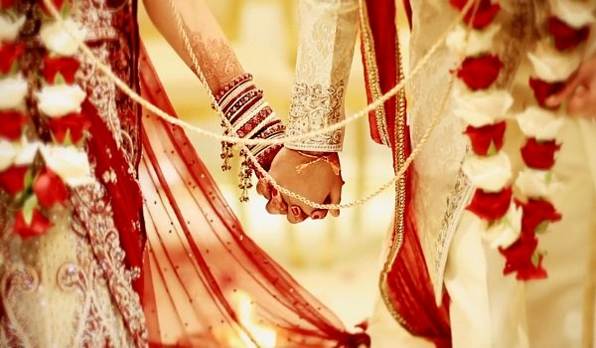
08B23
Hindu Kamma, British Citizen
D.O.B.: 23/01/1985 Height: 5Feet 8’’
Mother Tongue: Telugu
Qualification: MBA
Currently working as an Operations Manager.
Looking for a family orientated, educated professional, living in UK mostly.
09B23
Hindu Brahmin, Indian Citizen
D.O.B.: 21/09/1991 Height: 5Feet 9’’
Mother Tongue: Telugu
Qualification: B Tech (Computer Science)
Currently working as a Software Professional.
Hobbies: Reading, Watching Movies.
Looking for Telugu speaking Brahmin bride from a good family.
10B23
Hindu Kamma, British Citizen
D.O.B.: 29/08/1991 Height: 177Cms
Mother Tongue: Telugu
Qualification: MEng (Hons)
Currently working as a System Architect.
Hobbies: Badminton, Cycling, Photography.
Looking for professionally qualified bride from Hindu family who lives and works in the UK.

Slide 5
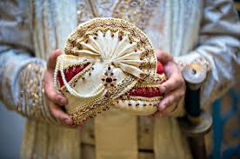
11B23
Hindu Naidu, French Citizen
D.O.B.: 23/10/1983 Height: 5Feet 10’’ Divorced
Mother Tongue: Telugu
Qualification: MBA
Currently working as a EMEA Sales Leader, Hitachi Ltd.
Hobbies: Playing Bansuri, Travelling, Cooking, Fitness and Reading.
Looking for mature and understanding partner located in the UK or willing to shift to UK, ideally engaged in a profession. I have a 7 year old Son who lives with my ex wife in India. I have parental obligations to visit him twice a year. Looking for a partner who understands this.
12B23
Hindu Vellalar, British Citizen
D.O.B.: 18/09/1995 Height: 5Feet 10’’
Mother Tongue: Tamil (Srilankan)
Qualification: M.Sc Astrophysics and Computer.
Currently working as a Solution Architect in IT.
Hobbies: Playing Badminton, Cycling, Gym and Compture Games.
Looking for a professionally qualified and family orientated bride.

Slide 6
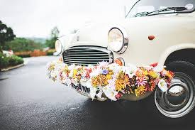
13B23
Hindu Sehdev, British Citizen
D.O.B.: 26/03/1972 Height: 5Feet 11’’
Mother Tongue: English/Hindi
Qualification: MB.ch.B/ Surgeon
Currently working as a Medical Doctor GP.
Hobbies: Watching Educational TV programme, Reading and Gym.
Looking for a suitable sincere/co-operative life partner from Hindu Family.
14B23
Hindu Jain, Indian Citizen
D.O.B.: 01/07/1988 Height: 6Feet - 183cm
Mother Tongue: Marathi
Qualification: MBBS, MD, DrNB cardiology
Currently working as a Senior Clinical Fellow at NHS.
Hobbies: Art, History, Trekkingelling, Music, Adventure, Travelling.
Looking for an open minded, liberal with good family values.
15B23
Hindu Kayasth, British Citizen
D.O.B.: 20/03/1988 Height: 5Feet 8’’
Mother Tongue: Hindi
Qualification: MBch, MSc, BSc
Currently working as a Doctor.
Hobbies: Reading, Music, Travelling, Cinema, Badminton.
Looking for a career driven partner, with strong family values, non smoker, ideally from UK or willing to settle in UK.

Slide 7
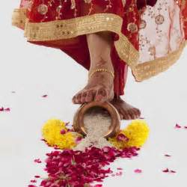
16B23
Hindu Kalinga, Indian Citizen
D.O.B.: 29/06/1988 Height: 5Feet 6’’
Mother Tongue: Telugu.
Qualification: Masters.
Currently working in AVL Powertrain UK Ltd.
Hobbies: Playing Cricket, spending time with family and friends, Travelling.
Looking for Indian Citizen Hindu girl, family oriented, kind and broad minded from India/UK.
17B23
Hindu Saiva Pillai, British Citizen
D.O.B.: 21/12/1974 Height: 6Feet 3’’
Mother Tongue: Tamil.
Qualification: Diploma.Mechanical Engg, B.Sc, P.G.D.BusinessAdminstration.
Currently working as Sales Manager Finance.
Hobbies: Watching Movies, Playing Cricket, Travelling, Music, Harakrishna.
Looking for Hindu, Good family background, willing to adjust and settle in UK.

Slide 8
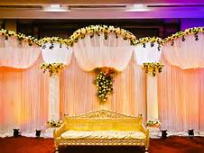
18B23
Hindu Balija, American Citizen
D.O.B.: 22/04/1982
Mother Tongue: Telugu.
Qualification: B.Tech.
Currently working in Life Sciences Strategy and Analytics, Deloitte.
Hobbies: Fitness, Running, Hiking, Sports, Cooking, Arts & Photography, Outreach Activities.
Looking for Someone with similar interests, Physically active and outgoing. Value Traditions and respectful to elders & extended family. Must be jovial in nature.
19B23
Hindu Jatav, Indian Citizen
D.O.B.: 17/09/1988 Height: 5Feet 6’’
Mother Tongue: English/Hindi.
Qualification: M.C.A.
Currently working as Lead Software Engineer.
Hobbies: Photography, Travel, Driving, Music.
Looking for Never Married Girl.

Slide 9
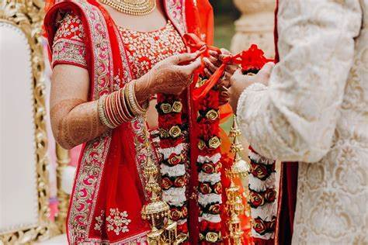
20B23
Hindu, British Citizen
D.O.B.: 21/07/1990 Height: 5Feet 4’’
Mother Tongue: Marathi + Bengali.
Qualification: BA Hons Business Management MSC in Hospitality and Tourism.
Currently working as a Transport Co-ordinator.
Hobbies: Listening to Music, Playing Cricket, Reading Books.
Looking for a Hindu Bride based in UK age(26-33), Veg or Nov-Veg doesn’t matter, Non-smoker, No Mangaliks, Any profession or student, Preferably Marathi or Bengali speaking.
21B23
Hindu Khatri, British Citizen
D.O.B.: 11/04/1983 Height: 5Feet 9’’
Qualification: BSc (Hons).
Currently working as a Manager for Government Dept.
Looking for a compatible and open-minded partner.
22B23
Hindu, British Citizen
D.O.B.: 30/08/1998 Height: 5feet 10’’
Qualification: MBBS, FRCS
Currently working as a Doctor
Hobbies: Sports, Photography, Reading, Travelling.
Looking for a like minded individual who wants to build a family together.

Slide 10
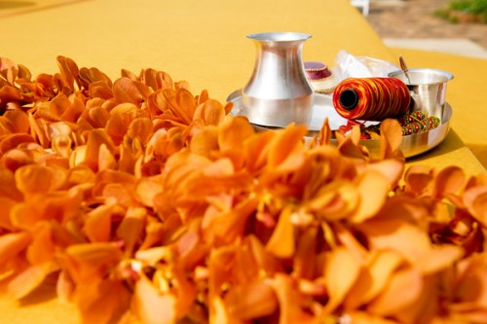
23B23
Hindu Kamma, British Citizen
D.O.B.: 23/06/1973 Height: 167CM Divorced
Qualification: B.E Mechanical
Currently working as an IT Management Professonal.
Hobbies: Reading Books, Watching Movies, Travel, etc.
Looking for a simple and understanding person.
24B23
Hindu Devanga Chettiar, British Citizen
D.O.B.: 23/07/1987 Height: 5Feet 9’’
Qualification: BSc, MA, Acca
Currently working as a Manager, PWC.
Hobbies: Reading, Cycling, Travelling, Watching Movies, Documentries.
Looking for a good looking, understanding, friendly, outgoing.
25B23
Hindu, British Citizen
D.O.B.: 24/10/1993 Height: 6Feet
Qualification: Meng Chemical Engineering
Currently working as a Lead Test Engineer.
Hobbies: Programming, Reading, Travelling, Cricket.
Looking for a best friend in my wife. An understanding partner.

Slide 11
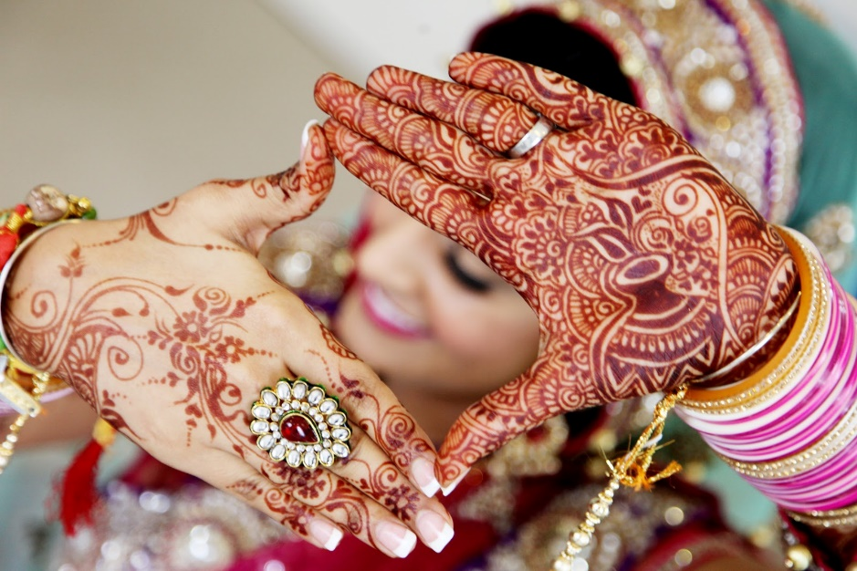
29B23
Hindu Khandayat, Indian Citizen
D.O.B.: 24/04/1984 Height: 161CM
Qualification: MBA
Currently working as Product Manager.
Hobbies: Watching Movies & Web series, Traveling, Cooking.
Looking for an educated, understanding, open minded, empathetic, one who belives in mutual respect and equal partnership. Cast no bar.
30B23
Hindu Brahmin, British Citizen
D.O.B.: 02/06/1996
Qualification: Diploma in Journalism
Currently working as Data Editor.
Hobbies: Running, Sport, Artwork through Chalk Pastels and pencil.
Looking for a Brahmin, vegetarian, well educated and working, good family background, born 1996 or after.
31B23
Hindu Brahmin, British Citizen
D.O.B.: 26/11/1994 Height: 6Feet 3’’
Qualification: BSC Computer Science
Currently working as a Banker.
Hobbies: Technology, Travelling, Swimming, Badminton, Current Affairs, Reading, Architecture and Art.
Looking for a kind, family and commitment orientated, similar values and born in UK.

Slide 12
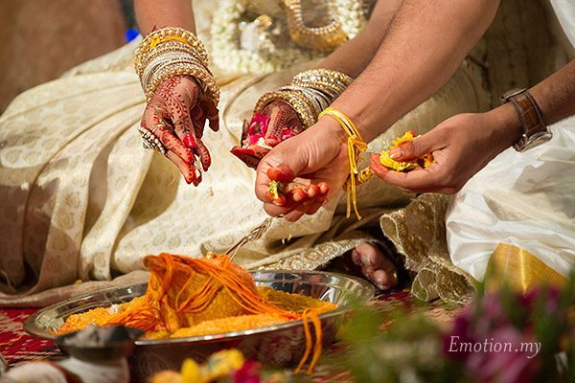
32B23
Hindu Kayastha, British Citizen
D.O.B.: 26/11/1994 Height: 173CM
Qualification: Graduate in Aerospace Engineering.
Currently working as an Associate Director
Hobbies: Hiking, Outdoor activites, Reading, Listening to Music, Sport.
Looking for a professional in IT Sector, Financial Sector, Doctor.

Slide 13
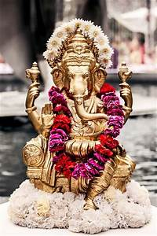
2022
01B22
Hindu Pillai, British Citizen
D.O.B.: 16/08/1978 Height: 5Feet 4’’
Mother Tongue: Tamil
Qualification: Msc Physiotherapy (Chemistry)
Hobbies: Travelling (East Asia), Hiking, Food, Cooking, Cycling, Swimming, Football, Computer Gaming, Movies, Writing, Home Improvement, Gardening.
02B22
Hindu Brahmin
D.O.B.: 02/04/1991 Height: 5Feet 4’’
Mother Tongue: Telugu
Qualification: MD(Interest Internal Medicine)/PhD(Biotech)
Hobbies: Hiking, Skiing, Reading, Outdoors, Cooking.
Looking for good values and culture.
03B22
Hindu Brahmin, British Citizen (Divorced)
D.O.B.: 16/04/1984 Height: 5Feet 11’’
Mother Tongue: Hindi
Qualification: B.Eng (Hons)
Hobbies: Tennis, Hiking & Badminton.

Slide 14
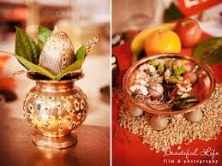
04B22
Hindu Kshatriya Raju, British Citizen
D.O.B.: 21/05/1983 Height: 5Feet 11’’
Mother Tongue: Telugu
Qualification: MS & BE
Hobbies: Table-tennis, Chess, Cricket, Gym workouts/Weight training, Jogging/Walking/Running, Yoga/Meditation, Badminton.
05B22
Hindu Khatri, British Citizen
D.O.B.: 29/10/1991 Height: 6Feet 2’’
Mother Tongue: English
Qualification: BSc/MSc
Hobbies: Football, Cricket, Formula 1, Reading, Cooking, Travelling.
Looking for Ideally someone who is Hindu Punjabi, British citizen, family oriented, educated professional (aged 27-31)
06B22
Hindu Naidu, British Citizen
D.O.B.: 07/08/1991 Height: 5Feet 11’’
Mother Tongue: Telugu
Qualification: B.Sc Hons
Hobbies: Cricket, Badminton.
Looking for Professional, family orientated.

Slide 15
07B22
Hindu Mudaliar, British Citizen
D.O.B.: 07/06/1993 Height: 172cms
Mother Tongue: Tamil
Qualification: B.E (Aerospace Engineering), MSc (Space Technology)
Hobbies: Travelling, Gym, DIY, Reading.
Looking for Professional, with good family values,working in the United Kingdom, preferably a British Citizen.
08B22
Hindu, British Citizen
D.O.B.: 14/09/1991 Height: 5Feet 7’’
Mother Tongue: English
Qualification: PhD Genetics
Hobbies: Cricket, Tennis, Badminton, Board Games, Gardening, Socilising.
09B22
Hindu Brahmin, Indian Citizen
D.O.B.: 26/06/1990 Height: 5Feet 10’’
Mother Tongue: Telugu
Qualification: MSc IIT Madras
Hobbies: Reading.
Looking for a Brahmin girl ready to settle in Bangalore, India.

Slide 16
10B22
Hindu Goldsmith, British Citizen
D.O.B.: 10/12/1982 Height: 5Feet 8’’
Mother Tongue: Punjabi
Qualification: Trade – Gas Engineer Electrician
Hobbies: Reading Books, Travelling.
Looking for a Hindu Punjabi down to Earth Person.
11B22
Hindu Devanga Chettiar, British Citizen
D.O.B.: 28/08/1994 Height: 5Feet 11’’
Mother Tongue: Kannada
Qualification: M.ENG(UK), MBA (USA)
Working as Investment Banking Associate, USA
Hobbies: Cricket, Running, Hiking, Climbing.
Looking for a Hindu, Preferably Kannada/Tamil Professional Girl Settled in UK or USA, Family Oriented, Kind and Broad Minded Individual .
12B22
Hindu Brahmin, Indian Citizen
D.O.B.: 21/03/1993 Height: 180cm
Mother Tongue: Hindi, Marwari
Qualification: B.Tech Mechanical
Working as Risk Consultant
Hobbies: Reading Books.
Looking for someone who can be around me, talk to me and especially have love for Indian Culture. One who is ready to understand and follow my culture.

Slide 17
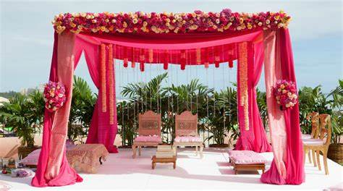
13B22
Hindu Brahmin, British Citizen
D.O.B.: 13/04/1993 Height: 5Feet 7’’
Mother Tongue: Kannada
Qualification: BA
Working in Banking
Hobbies: Reading, Listening to Music, Travelling, Watching movies, Gym, Cricket.
Looking for British Citizen, who is Hindu and is able to work in or around London. Family oriented, educated professional (aged 25-29) who is friendly, warm with a good sense of humour and likes travelling.
14B22
Hindu Naidu, Indian Citizen
D.O.B.: 19/10/1991 Height: 5Feet 11’’
Mother Tongue: Telugu
Qualification: BE
Working in Solutions Architect In Cognizant UK
Hobbies: Music, Travelling.
Looking for partner to journey through rest of the life with Indian Culture & values. Preferably from Naidu, open to others.

Slide 18
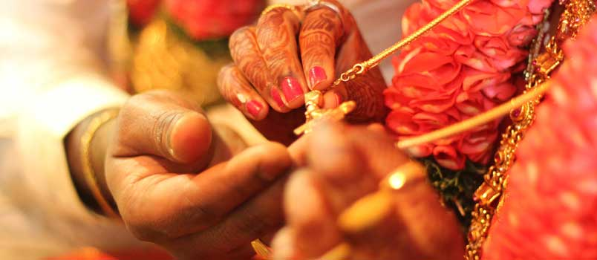
15B22
Hindu Vysyas, Indian Citizen
D.O.B.: 10/12/1991 Height: 5Feet 11’’
Mother Tongue: Kannada and Telugu
Qualification: ME., MSc
Working as Electronics Engineer
Hobbies: Playing Batminton, Blogging on Quora.
Looking for well educated, kind hearted girl from a decent family, who can be my wife and best friend for life. Preferably, Telugu/Kannada speaking, vegetarian, non-drinker and non-smoker and belives in God.
16B22
Hindu Brahmin, Indian Citizen
D.O.B.: 14/04/1990 Height: 5Feet 11’’
Mother Tongue: Telugu
Divorced
Qualification: B.Tech, M.S.
Working as Software Engineer
Hobbies: Listening to Music, Reading, Photography, Travelling, Hikes, Going to Parks and Museums.
Looking for a life partner who is understanding, caring, well-educated and family-oriented. Should be non-smoker and non-drinker. Must be living in the UK currently and willing to settle here.

Slide 19
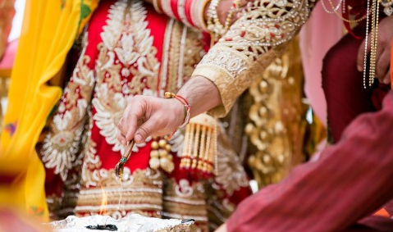
17B22
Hindu Punjabi, Indian Citizen
D.O.B.: 25/02/1995 Height: 5Feet 8’’
Mother Tongue: Hindi
Qualification: MBBS, MSc.
Working as Scientist
Hobbies: Tennis, Badminton, Hiking.
Looking for spiritual mindset partner who relish experiencing life with love and devotion.

Slide 20
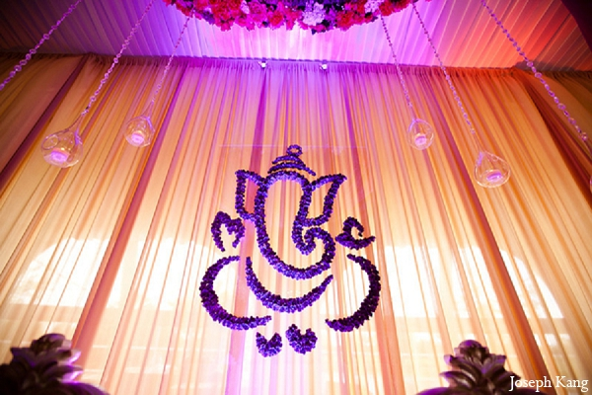
2021
01B21
Hindu Naickar (Kamma), British Citizen
D.O.B.: 18/12/1990, Height: 5feet 7’’
Mother Tongue: Marathi
Qualification: B.Sc, MBBS
Working with NHS in London
Hobbies: Badminton, Learning Languages, Listening to Music, Playing Guitar, Exploring new Places and Experiencing Culture & History
Looking for Medical Professional, Settled in UK, Mix of Traditional & Modern values, Non Smoker and Non Drinker.
02B21
Hindu Arya Vyshyas(Guptas/Shetty’s/Komati), Indian Citizen
D.O.B.: 14/04/1991 Height: 165 cms
Mother Tongue: Telugu
Qualification: Masters (Software Engineering)
Hobbies: Watching Movies, Learning New Skills.

Slide 21
03B21
Hindu Brahmin, British Citizen
D.O.B.: 16/08/1980, Height: 5feet 8’’
Mother Tongue: English
Qualification: A Levels & GCSEs
Working as Loader/Packer
Hobbies: Walking, TV, Politics, News
Looking for kind natured, simple & homely future wife.
04B21
Hindu & Sikh, British Citizen
D.O.B.: 03/05/1994, Height: 5feet 5’’
Mother Tongue: Punjabi
Qualification: Bachelors Degree in Machanical Engineering
Working as Data Administrator
05B21
Hindu Padmashali
D.O.B.: 24/07/1993, Height: 5feet 8’’
Mother Tongue: Telugu
Qualification: B Tech
Working as Salesforce Consultant
Hobbies: Photography, Music, Watching Movies
Looking for decent family background and liberal values.

Slide 22
06B21
No Longer Available
07B21
Hindu Girnara Soni, British Citizen
D.O.B.: 10/03/1988, Height: 5feet 9’’
Mother Tongue: Gujarati
Qualification: B Tech
Working as Business man
Looking for a vegetarian girl and family orientated.
08B21
Hindu Nai Brahmin, British Citizen
D.O.B.: 16/06/1992, Height: 5feet 5’’
Mother Tongue: Telugu
Qualification: MD, Specialty Trainee in GP
Working as Specialty Trainee in GP, NHS
Hobbies: Computers, Travel, Technology, Movies
Looking for preferably doctors, open to other professionals.

Slide 23
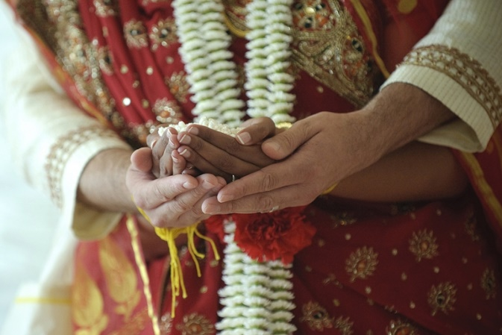
09B21
Hindu Karuneegar, British & Indian Citizen
D.O.B.: 18/08/1994, Height: 5feet 7’’
Mother Tongue: Tamil
Qualification: MS (Scientist), Specialization in Pharmacology
Working as Scientist
Hobbies: Reading, Cooking, Gym, Long Walks, Technology, Watching Movie
Looking for Hindu, Pure Vegetarian, Slim, Good Looking, Family Oriented, Employed Girls.
Brahmin, Karuneegars, Saiva Only need.

Slide 24
2020
01B20
Hindu Reddy, British Citizen
D.O.B.: 29/10/1976, Height: 5feet 6’’
Mother Tongue: Telugu
Qualification: MBBS
Working as an NHS Consultant
02B20
Hindu Dhawan, Indian Citizen
D.O.B.: 11/01/1987 Height: 5feet 4’’
Mother Tongue: Punjabi
Qualification: MA in Business Management
Hobbies: Listening to music, cinema, reading, walking
Looking for someone who is caring and understanding and who will be my companions for life.
03B20
Hindu Kannada Veerashiva, Indian Citizen based in UK on Tier 4 Visas
D.O.B.: 14/1/1991 Height: 6feet
Mother Tongue: Kannada
Qualification: BE – Civil, MS (UK) in Civil Engineering
Hobbies: Billiards, horse riding, gardening, landscaping, football
Looking for someone who is good looking and qualified

Slide 25
04B20
Hindu Khatri, British Citizen
D.O.B.: 28/6/1986 Height: 5feet6’’
Mother Tongue: English
Qualification: BE – Electronic Engineering
Currently self employed as a Software Designer
Hobbies: Family, exercise
05B20
Hindu Brahmin, Based in Switzerland
D.O.B.: 12/7/1978 Height: 5feet10’’
Mother Tongue: Tamil
Qualification: M Sc. Business Admin
Currently working as a CEO in WDS, Switzerland
Hobbies: Fitness/ Motor Boat driving
06B20
Hindu Brahmin, British Citizen
D.O.B.: 13/11/1992 Height: 5feet10’’
Mother Tongue: Punjabi
Qualification: M Sc. Engineering Business
Currently working as Europe Customer Manager – Rolls Royce
Hobbies: Playing sports, gym, Punjabi music, travelling, cooking, watching films, shopping, dining at nice places
Looking for someone who is educated, nice natured, modern, well-settled and wanting a serious relationship

Slide 26
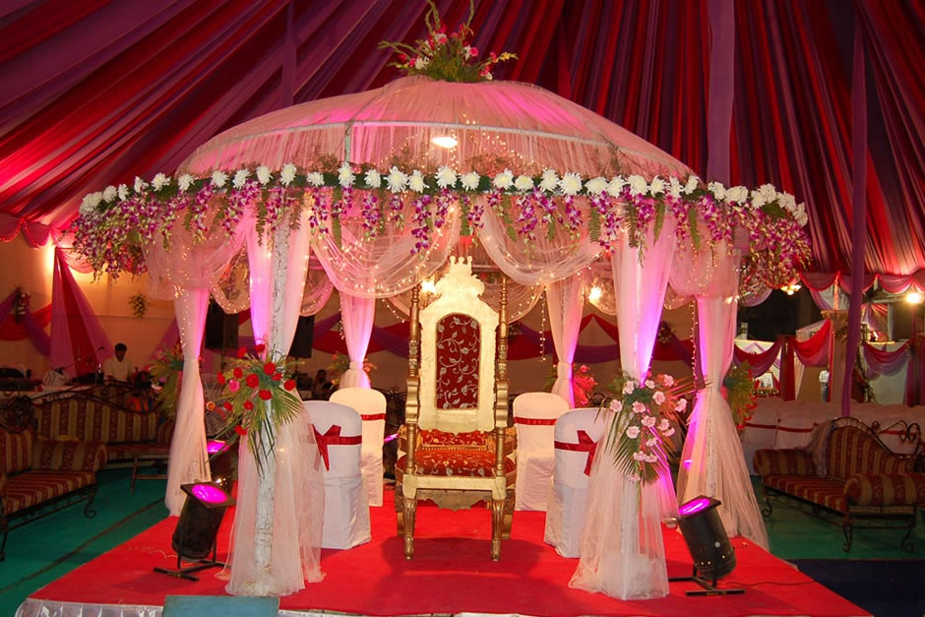
07B20
Hindu, British Citizen
D.O.B.: May 1986 Height: 5feet7’’
Mother Tongue: Hindi
Qualification: MRCGP – General Practice
Currently working as a General Practitioner
Hobbies: Watching films, reading, playing tennis, music, sports
Looking for a suitable match preferably doctor, dentist or a post graduate
08B20
Hindu Brahmin, British Citizen
D.O.B.: 30/9/1993
Mother Tongue: Hindi/ Punjabi
Qualification: MBCHB
Currently working for NHS (Hospital)
Hobbies: Sports, reading, travelling
09B20
Hindu, Divorced, Indian Citizen on Residence Permit
D.O.B.: 20/6/1981, Height: 5feet 9’’
Mother Tongue: Tamil
Qualification: M Sc. & PGCE (Teacher Training) Specialised in Engineering & Physics
Currently working in a Secondary School as a Science Teacher
Hobbies: Listening to music, watching films, playing badminton and travelling
Looking for a Hindu, well educated, family oriented, kind and broad minded individual

Slide 27
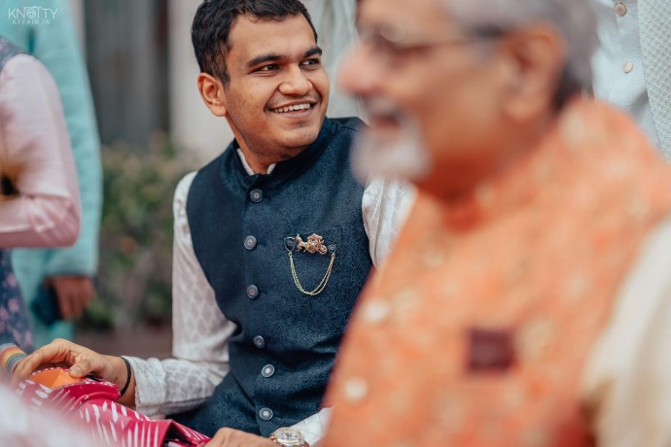
10B20
Hindu Marwadi, Indian Citizen based in Germany on Work Permit
D.O.B.: 19/12/1994, Height: 5feet 8’’
Mother Tongue: Hindi
Qualification: M Sc. In Investment Banking & Capital Markets
Currently working as an Associate DC Placement Advisors
Hobbies: Movies, comedy, meeting new people, travelling, running, cycling
Looking for a partner who would like travelling, explore hidden places around the world, honest and adaptable. Would like a spontaneous and an open-minded partner.
11B20
No Longer Available
12B20
Hindu Gharwali Brahmin, Indian Citizen based in Mumbai
D.O.B.: 3/9/1987, Height: 5feet 7’’
Mother Tongue: Hindi
Qualification: MBA – Consulting in Durham UK
Currently working in a Consumer Electronics Company
Hobbies: Travelling, reading, biking, listening to music, watching movies, eat and work
Looking for someone who is mature, well read, travelled, career oriented, likes to eat and travel and a bit accommodating with new people.

Slide 28
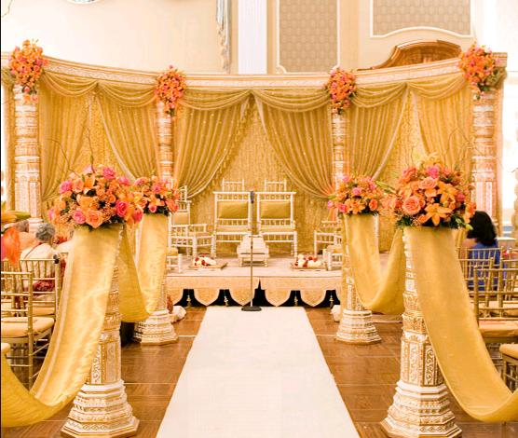
13B20
Hindu Khatri/ Brahmin, British Citizen
D.O.B.: 24/6/1978, Height: 6 feet
Mother Tongue: English
Qualification: PhD – Engineering & Chemistry
Currently working in University Professor in Chemical Engineering
Hobbies: Reading, travelling, playing sports, walking, cycling, learning about different cultures, cooking, gardening, DIY
Looking for a caring, kind-hearted and family-oriented person
14B20
Hindu Niyogi/ Brahmin, British Citizen
D.O.B.: 28/04/1995, Height: 5feet 11’’
Mother Tongue: Telugu
Qualification: Masters in Engineering – Aeronautical
Currently working in Leonardo Helicopters
Hobbies: Play Carnatic Violin, Biking, physical fitness
Looking for a vegetarian, professional, working in the UK
15B20
Hindu Punjabi/ Brahmin
D.O.B.: 15/7/1986, Height: 5 feet 8’’
Mother Tongue: English/ Punjabi
Qualification: Degree – Business Management
Currently working as a Senior Finance Manager in Bank
Hobbies: Gym, eating out, socialising, films family, cars
Looking for family oriented person

Slide 29
16B20
Kannada Brahmin, British Citizen currently based in Dubai
D.O.B.: 18/10/1993, Height: 6 feet
Mother Tongue: Kannada
Qualification: BE - Hons – Electrical/ Electronics
Currently working as an Engineer
Hobbies: Sports, Keep-fit, Music, Travel
Looking for a partner from professional background, height above 5feet 4’’, good looking from a decent family background with interest in similar hobbies.
17B20
Tamil Iyer, British Citizen
D.O.B.: 13/03/1997, Height: 5 feet 8’’
Mother Tongue: Tamil
Qualification: B Sc. – Hons - Optometry
Currently working as an Optometrist
Hobbies: Photography, Reading, Music, Travelling
Looking for a good looking professional, Hindu Brahmin, preferably South Indian vegetarian girl with good family background
18B20
Hindu Kamma, Indian Citizen
D.O.B.: 8/9/1981, Height: 5 feet 6’’
Mother Tongue: Telugu
Qualification: B Tech/ BE – Computer Science
Looking for an understanding girl settled in UK or India

Slide 30
19B20
No Longer Available

