Slide 1
BALAJI TEMPLE MATRIMONIAL SERVICES REGISTERED ASPIRANTS BRIDES

Slide 2
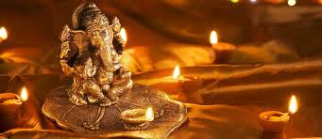
2023
01G23
Hindu Gaundar, British Citizen
D.O.B.: 10/11/1993 Height: 5feet 2’’
Qualification: MBChB Medicine
Currently working as a trainee GP Doctor
Hobbies: Reading, Writing, Watching TV Dramas.
Looking for a progressive Indian Groom in the Medical field.
02G23
Hindu Arora, Indian Citizen
D.O.B.: 09/08/1985 Height: 5feet 2’’
Qualification: B.COM
Currently working as a Banker
Hobbies: Travelling, Music.
Looking for a family oriented, simple man.

Slide 3
03G23
No Longer Available
04G23
Hindu Punjabi Arora, Indian Citizen
D.O.B.: 17/12/1986 Height: 5feet 2’’
Qualification: Student (Masters)
Divorced
Currently working in Teaching
Hobbies: Yoga, Watching Bollywood Movies, Meditation.
05G23
Hindu Vaani Chettiar, British Citizen
D.O.B.: 21/11/1995 Height: 151CM
Qualification: MBBS, Cambridge, UK
Currently working as Foundation Doctor
Hobbies: Very social, spending time with family, friends, travelling, singing.
Looking for a pleasant, family oriented groom, friendly, honest, Indian family values, respects women social, currently living in UK or is willing to settle down in UK!

Slide 4
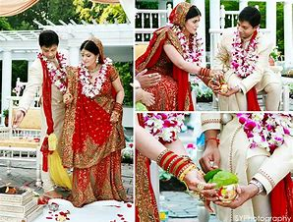
06G23
Hindu Jain, British Citizen
D.O.B.: 25/11/1994 Height: 5feet 9’’
Qualification: BE Chemical Engineering
Currently working as Risk Analyst
Hobbies: Cooking, Reading, Hiking, Travelling, Gym and Sports.
Looking for Compatible Partner
07G23
Hindu Brahmins, Indian Citizen
D.O.B.: 29/11/1989 Height: 5feet 3’’
Qualification: MBBS Doctor
Divorced
Currently working as a Junior Doctor in Medicine
Hobbies: Art, Cooking, Dancing, Pet Animals, Gardening.
Looking for Groom/Boy who is settled in UK and Doctor or Engineer as Profession.
08G23
Hindu Pillai, American Citizen
D.O.B.: 20/09/1993 Height: 5feet 2’’
Qualification: BSC Economics
Currently working Audit at KPMG, London
Hobbies: Listening to music, attending concerts, watching movies, playing piano, ballet & tap dancing, love to travel and explore different countries and their cultures.
Looking for a highly qualified post-graduate professional preferably in Medicine, Law, Dentistry, Banking, Accountancy or Senior Manager IT.

Slide 5
09G23
Hindu Kapu, Indian Citizen
D.O.B.: 29/05/1993 Height: 5feet 5’’
Qualification: Masters in Data Science and Analytics
Currently is a Student
Hobbies: Travelling, Painting.
Looking for a good looking, Understanding.
10G23
Hindu Brahmin, Indian Citizen
D.O.B.: 16/07/1999 Height: 5feet 6’’
Qualification: B.Tech (EEE)
Currently is working as a Software Engineer
Hobbies: Watching Movies, Travelling and Music.
Looking for a good looking groom born after 1995 & strictly vegetarian. Setelled in India, UK, Europe or USA.
11G23
Hindu Mudaliar, British Citizen
D.O.B.: 18/06/1997 Height: 155CM
Qualification: MBBS
Currently is working in NHS
Hobbies: Reading, Nature, Games, Music, Cooking.
Looking for a groom from Medical background, well educated, family orientated, friendly and outgoing.

Slide 6
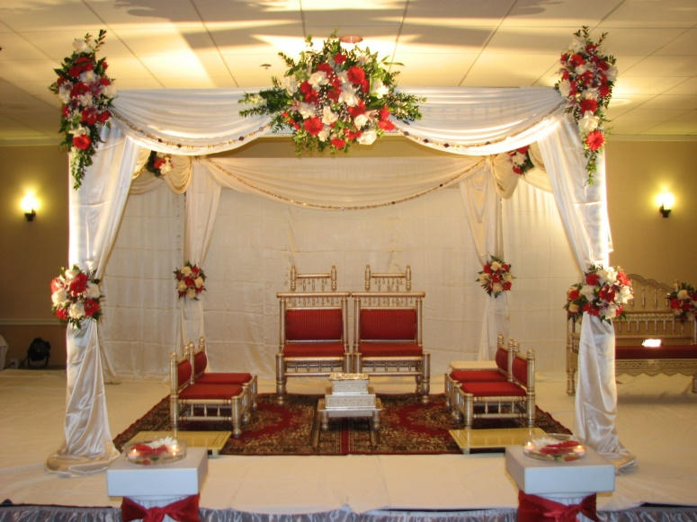
12G23
Hindu Gohal, Indian Citizen
D.O.B.: 21/01/1993 Height: 5feet 4’’
Qualification: Masters in English Linguistics & Commerce
Currently is working as a Teacher
Hobbies: Reading Books, Dance, Travel.
Looking for a boy who is educated, well settled, religious and down to earth.
13G23
Hindu Naidu, Indian Citizen
D.O.B.: 17/09/1996 Height: 5feet 8’’
Qualification: MBBS
Currently is working as a Junior Doctor
Looking for Telugu/Tamil Doctor Groom working in the UK.
14G23
Hindu Brahmin, Indian Citizen
D.O.B.: 05/05/1989 Height: 5feet 5’’
Qualification: MBBS, MD, MSc
Currently is working as a Global Patient Safety Physician, Ipsen Pharma Ltd
Hobbies: Table Tennis, Swimming, Music, Cooking.
Looking for a non-smoker, preferably willing to settle in UK.

Slide 7
15G23
Hindu Brahmin, British Citizen
D.O.B.: 19/09/1994 Height: 5feet 5’’
Qualification: ICAEW Chartered Accountant, BSC Computer Science
Currently is working as a Technology Risk Consultant
Hobbies: Music, Travelling, Cooking, Watching TV Shows.
Looking for a vegetarian Bramin boy from a decent family background who is friendly, caring and with a good sense of humor. Preferably in and around London.
16G23
Hindu Balija
D.O.B.: 21/06/1983 Height: 5feet 6’’
Qualification: Graduate
Currently is working as a Primary School Teacher
Hobbies: Going for walks in nature, Keeping fit, Listening to Music, Dance, Reading and Travelling.
Looking for a kind, understanding and loyal to be a long term partner that leads to marriage.
17G23
Hindu Kayasth, British Citizen
D.O.B.: 25/06/1997 Height: 155 CM
Qualification: Masters in Optometry
Currently is working as an Optometrist
Looking for Professional based in UK.

Slide 8
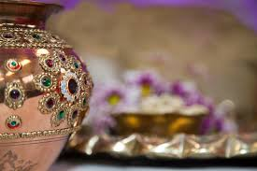
18G23
Hindu Khatri, British Citizen
D.O.B.: 14/08/1981 Height: 5feet 3’’ Divorced
Qualification: M.Pharmacy
Currently is working as a Pharmacist.
Hobbies: Gym, Cooking, Writing.
Looking for a kind, family and commitment orientated, similar values, preferably vegetarian and born in UK.
19G23
Hindu Baniya, Indian Citizen
D.O.B.: 07/12/1994 Height: 5feet 4’’
Qualification: MBBS
Currently working with NHS.
Hobbies: Travelling, Reading.
Looking for a suitable match with similar background.
20G23
Hindu Sonar, British Citizen
D.O.B.: 18/06/1988 Height: 5feet 7’’
Qualification: BSc Computer Science
Currently is working as an IT Software Engineer.
Hobbies: Gym, Spending time with family.
Looking for a clean shave, tall boy who is genuine and looking for serious relationship only.

Slide 9
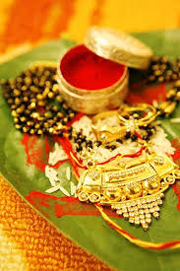
21G23
Hindu Veerashiva Lingyath, British Citizen
D.O.B.: 24/07/1996 Height: 5feet
Qualification: MBBS, BSc
Currently is working as a Doctor.
Hobbies: Country side and forest walks, Travel, Muesums.
Looking for a kannadigas raised in UK aged 26-32, vegetarian, non-smoking and devoted individuals.
22G23
Hindu, British Citizen
D.O.B.: 18/09/1997 Height: 5feet 7’’
Qualification: MBBS
Currently working as a Doctor
Hobbies: Sports, Photography, Reading, Travelling.
Looking for a like minded individual who wants to build a family together.
23G23
Hindu Rai and Kshatriya, British Citizen
D.O.B.: 17/07/1997 Height: 5feet 5’’
Qualification: BSc Biomedical Science, MSc Biomedical Engineering
Currently is studing Coding.
Hobbies: Reading, Travelling, Cooking, Drawing and Painting.
Looking for a hindu groom who is also a British citizen or Indian Citizen working already in UK. Ideally 5ft.5’’ and above to 6ft height. Family oriented person who is respectful in every manner of life. Cast no bar, ideally considered from any Hindu and South Indian language speaking family.

Slide 10
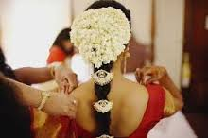
24G23
Hindu chettiar, Indian Citizen
D.O.B.: 07/05/1986 Height: 5feet 4’’
Qualification: B.Tech.
Currently working in IT - Product Delivery.
Hobbies: Swimming, Craft, Travelling and Painting.
Looking for a professiona, good companion, friendly person, non smoker, family oriented person.
25G23
Hindu Visvakarma, British Citizen
D.O.B.: 24/08/1998 Height: 5feet 3’’
Qualification: MBBS.
Currently working as a Junior Doctor
Hobbies: Swimming, Travelling.
Looking for a bridegroom with professional background, employed and settled in UK.
26G23
Hindu Vellalar, Indian Citizen
D.O.B.: 28/12/1993 Height: 165 CM
Qualification: B.Tech, HRLP.
Currently working in Goldman Sachs – Associate.
Hobbies: Science fiction books, Movies, Writing, Cooking, Yoga.
Looking for a qualified, professional, kind, supportive partner.

Slide 11
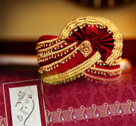
27G23
Hindu, British Citizen
D.O.B.: 13/03/1995 Height: 4feet 11’’
Qualification: ACCA.
Currently working as a Senior Management Accountant.
Hobbies: Bharathanatyam, Travelling, Reading, Gaming.
Looking for a non vegetarian, british citizen, someone who likes to travel, lives in London, good profession, family-orientated, south indian.
28G23
Indian Citizen
D.O.B.: 22/09/1988 Height: 5feet 3’’
Qualification: B.E, M.S.
Currently working as a Senior Electrical Engineer.
Hobbies: Travelling, Trekking, Adventurous Sports, Reading Etc.
Looking for somebody willing to travel and explore.
29G23
Hindu Gujarati, British Citizen
D.O.B.: 11/02/1980 Height: 5feet 2’’
Qualification: Degree.
Hobbies: Eating out, Going out for Tea/Coffee/Water/Juice, Food, Cinema, Walking, Swimming, Listening to Music, Dancing, Like to visit different places and Resting.
Looking for a good person/qualities, mostly similar interests and affluent knows they want to get married to me and not taking a long time to get married to me.

Slide 12
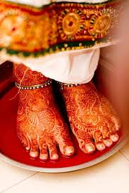
30G23
Hindu Tamil Iyer, Indian Citizen
D.O.B.: 01/05/1985 Height: 5feet 2’’
Qualification: LLB Honors.
Currently working as a Principle Assosiate.
Hobbies: Watching Sports, Comedy Shows, Bollywood Films.
Looking for a well educated person and good family.
31G23
Hindu Kallar, British Citizen
D.O.B.: 07/04/1988 Height: 5feet 4’’
Qualification: MBChB (Doctor).
Hobbies: Music, Singing & Dancing.

Slide 13
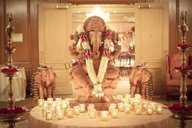
2022
01G22
Hindu Mudaliyar, Indian Citizen
D.O.B.: 04/03/1993 Height: 150CM
Qualification: BE., MS., PhD
Currently working as Clinical Researcher/Scientist at Policlinico Di Bari
Hobbies: Reading, Writing Potries, Travelling, Movies, Dance, Mehendi Designing, Walking, Yoga and Cooking.
Looking for a soulmate, who is down to Earth, Understanding, Enjoys every moment of Life and Be my best friend for rest of my Life.
02G22
Hindu Pillai, Indian Citizen
D.O.B.: 15/11/1997 Height: 170CM
Qualification: M.S(Masters Of Science)
Currently working in Embeded Systems
Hobbies: Reading Books, Listening to Music, Travelling.
Looking for Preferably Masters Degree and Above with Good Family Values.

Slide 14
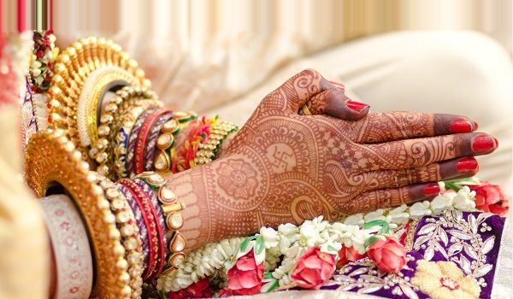
03G22
Hindu Kamma, Indian Citizen
D.O.B.: 09/06/1995 Height: 5feet 1’’
Qualification: Masters in UK
Currently working in Deloitte London
Hobbies: Music, Travelling, Dance and Literature.
Looking for Employed in Bank/ Software/ Audit/ Doctor.
04G22
Hindu, Indian Citizen (Divorced)
D.O.B.: 02/05/1992 Height: 5feet 6’’
Qualification: BTech
Currently working as Software Consultant
Hobbies: Reading, Travelling, Cooking.
Looking for a life partner who is family-oriented, committed and willing to support my carrer intrest. Should be a vegetarian and non smoker, preferably a non drinker. Must be living in UK currently.
05G22
Hindu, UK Citizen
D.O.B.: 10/11/1989 Height: 5feet 5’’
Qualification: BSC Business
Currently Self-employed
Hobbies: Singing, Yoga.
Looking for Bridegroom : Successful professional entrepreneur in Fintech, IT and banking. Someone open-minded, ambitious, confident with an affluent background, well settled.

Slide 15
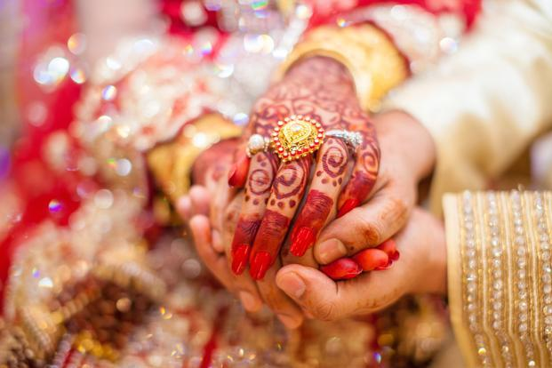
06G22
Hindu, Indian Citizen
D.O.B.: 28/03/1993 Height: 159cm
Qualification: MBBS, MRCGP, DRCOG General Practice
Currently GP Training
Looking for an understanding, respectable and well educated person. Preferably Telugu origin, willing to settle in the UK
07G22
Hindu Naidu, UK Citizen
D.O.B.: 17/07/1984 Height: 5feet 1’’
Qualification: MBA Supply Chain
Currently a Customer Success Manager
Hobbies: Yoga, Reading, Hiking.
Looking for Educated, well-mannered, established in career or business.
08G22
Hindu Vellalar/Pillai, Malaysian Citizen
D.O.B.: 16/05/1977 Height: 5feet 5’’
Qualification: Ba Accounting & Finance, Association Of Chartered Certified Accountant
Currently is a HOD at a Malaysian listed conglomerate
Hobbies: Walks, Hikes, Nature Activities, Yoga, Piano, Books, DIY, Cafes Hangouts, Travels.
Looking for Professional, Responsible & Adventurous Male.

Slide 16
09G22
No Longer Available
10G22
Hindu Pillai, British Citizen
D.O.B.: 13/06/1992 Height: 5feet 1’’
Qualification: MA Architecture
Currently is a Architectural Designer
Hobbies: Reading, Movies, Gym.
Looking for someone who is kind, caring, family-orientated and with good values.
11G22
Hindu Veersaivam, Indian Citizen
D.O.B.: 31/12/1992 Height: 5feet 3’’
Qualification: B-Tech Information Technology
Currently is a Software Professional
Hobbies: Gym, Walking & Travelling.
Looking for compatible partner who is open-minded, independent and empathetic. One who believes in mutual respect and equal partnership. Caste no bar.

Slide 17
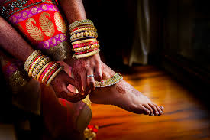
12G22
Hindu Brahmin, Indian Citizen
D.O.B.: 00/06/1996 Height: 156cm
Qualification: MBBS
Currently is a Resident in Emergency Medicine
Looking for vegetarian, non smoker, non drinker, caring and understanding, good character who values Indian culture, family and relationship, preferably Doctors, other professionals holding a post graduate degree.
13G22
Hindu Brahmin, British Citizen
D.O.B.: 22/09/1989 Height: 5feet 5’’
Qualification: MBBS FRCR
Currently is a Doctor at NHS
Hobbies: Badminton, Art & Travel.
Looking for professional settled in UK.
14G22
Hindu Pillai, Indian Citizen
D.O.B.: 14/11/1994 Height: 5feet 11’’
Qualification: MBBS
Currently is a Senior House Officer
Hobbies: Fiction (Books/Movies), Travel & Music.
Looking for a professional working towards a career in the United Kingdom.

Slide 18
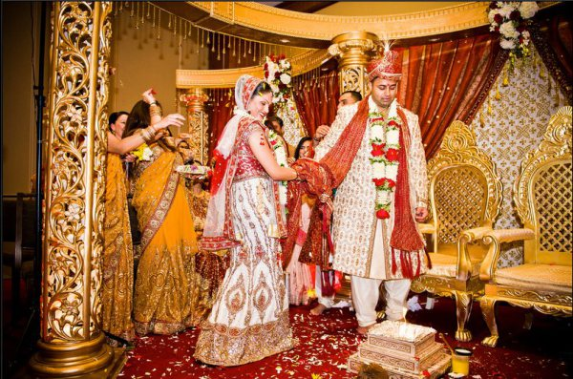
15G22
British Citizen
D.O.B.: 12/02/1995 Height: 5feet 1’’
Currently is a Software Developer.
16G22
Hindu Reddy, British Citizen
D.O.B.: 23/03/1998 Height: 5feet 8.5’’
Qualification: BDS
Currently is a Associate Dentist
Hobbies: Indian Classical Dance, Photography.
Looking for a Dentist /Doctors only Please.

Slide 19
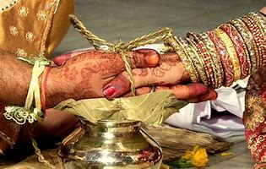
2021
01G21
Hindu Brahmin – Tamil & Telugu background, British Citizen
Dorn : October 1997, Height: 5’3.5’’ Mother Tongue : Telugu (knows Tamil)
Qualification: B.Sc. Maths & Actuarial Science, presently working as Graduate Actuarial Trainee.
Also undertaking exams & training to eventually qualify as a Fellow of the Institute of Actuaries (FIA).
Hobbies: Keeping-fit, Sports, Cooking, Listening-Music, Travel, Reading, Public-speaking, Entrepreneurship.
Prefers a professional qualified in any of : Actuary / CFA / ACA / ACCA /Data Science / IT Software / Engineering.
Looking for a Tamil (or) Telugu, Brahmin Vegetarian, life-partner, who is caring, family-oriented, committed, and willing to be supportive of my career interests and hobbies.
02G21
Hindu Muthurajah, British Citizen
D.O.B.: 06/02/1986 Height: 5feet 2’’
Qualification: ACMA (CIMA) and MSc
Currently working as Chartered Accountant (Head of Finance)
Hobbies: Youtube, Podcasts, Gardening, Yoga, Meditation, Music and Cooking.
Looking for Male aged 36-39 settled in UK. Must be Indian or Colombotamil working in a senior position like businessman, banker, dentist and likewise. Education slightly less than bride is ok. Background and chart match is key. Non smoker, non drinker and non vegetarian. Must be living in UK.

Slide 20
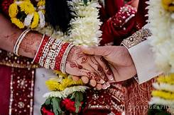
03G21
Hindu Sri-Vaishnavas, Indian Citizen
D.O.B.: 01/03/1996 Height: 5feet 4’’
Qualification: MCA (Computer Applications)
Currently Student
Hobbies: Cooking & Reading.
Looking for an unmarried bridegroom from Sri Vaishnava or Brahmin community/sub caste in well placed and remuneration with background of good character, good family with age below 30 years.
04G21
Hindu Vishwakarma, Indian Citizen
D.O.B.: 21/10/1996 Height: 5feet 7’’
Qualification: Bachelor of Engineering
Currently Student
Hobbies: Classical dance (Bharatnatyam), Yoga.
Looking for Suitable Groom with clean habits, family oriented person.

Slide 21
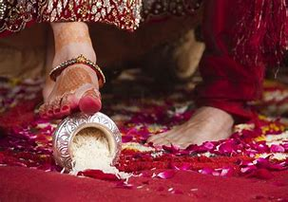
05G21
No Longer Available
06G21
Hindu Goud Saraswat, Indian Citizen
D.O.B.: 15/10/1996 Height: 5feet 6’’
Qualification: Bachelor in Cardio Vascular Technology
Currently Working as Specialist Cardiac Physiologist
Hobbies: Cooking, Swimming, Gym, Music.
Looking for Engineeror Doctor with height 5’7’’ or above, from GSB family, age gap of upto 5 years, willing to settle in Uk.
07G21
Hindu Bramin (Iyer), Indian Citizen
D.O.B.: 05/03/1992
Qualification: MS (I T)
Currently Working as Test Engineer
Looking for any Bhramin.

Slide 22
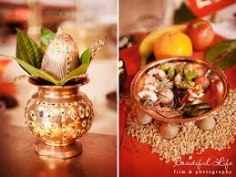
2020
01G20
No longer available
02G20
Hindu Punjabi, British Citizen
D.O.B.: 9/12/1986 Height: 5’4’’
Qualification: B Com (India), MBA (UK)
Currently working as a Head of Product Development in Limited Company based in London
Hobbies: Reading, Travelling, Music, Cooking, Yoga
Looking for a UK resident, preferably a vegetarian and non-smoker, well settled and educated, Punjabi or Intercast.

Slide 23
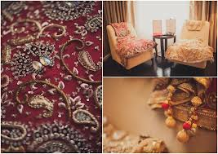
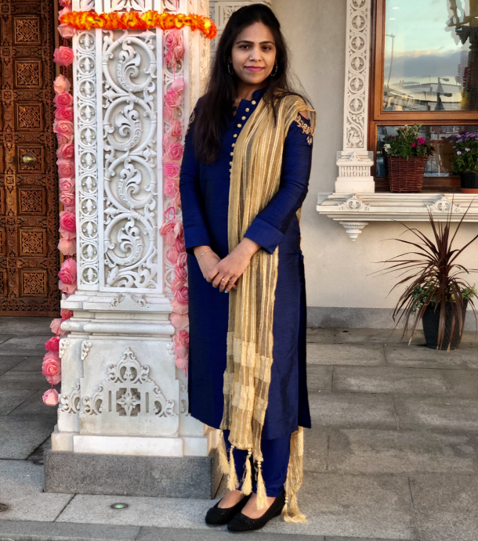
03G20
No Longer Available
04G20
Hindu Balija, Divorced
D.O.B.: 5th August 1987
Qualification: Masters in Information Technology
Currently working as a Customer Service Assistant
Looking for a person from a decent family and settled in UK.
05G20
Hindu Brahmin, Indian Citizen with Tier 2 Visas
D.O.B.: 20th Jul 1990 Height: 5feet3’’
Mother Tongue: Kannada
Qualification: MBBS
Currently working as a FY2 in Darlington Memorial Hospital
Hobbies: Reading, travelling, listening to music
Looking for a Kannada speaking groom preferably medical profession from Brahmin community who lives/ works in UK

Slide 24
06G20
Hindu Brahmin, Indian Citizen based in UK on Work Permit
D.O.B.: 6th May 1994 Height: 5feet 5’’
Qualification: MBBS (University of Sheffield)
Currently working as a Doctor – Doing post graduate training in Internal Medicine
Hobbies: Listening to music, watching movies, yoga, singing
Looking for a humble, honest and caring life partner. Preferably a vegetarian
07G20
Telugu Arya Vyasa, British Citizen
D.O.B.: October 1995 Height: 4feet 9’’
Qualification: BA – Honors (Politics & Sociology)
Currently working as a Payroll Accountant
Hobbies: Badminton/ Gym, reading, music, watching TV/ films
Looking for a suitable match within the UK and preferably in the same community, vegetarian. Should ideally be settled and have UK citizenship.
08G20
Hindu Brahmin, Europe Citizenship
D.O.B.: 22/1/1992 Height: 5feet 2’’
Qualification: MBChB, MRCP, BMedSci
Currently working as an Oncologist
Hobbies: Yoga, hiking, baking, singing, reading
Looking for an educated Brahmin, ambitious, kind, dharmic, good family values, vegetarian, non-drinker, non-smoker

Slide 25
09G20
Hindu Tamil, British Citizen
D.O.B.: 23/9/1986 Height: 5feet 5’’
Qualification: MRCGP/ Fellowship in MSK
Currently working as a GP
Hobbies: Home decorating, painting, playing tennis, travelling
Looking for a Doctor settled in UK
10G20
Hindu Malayalam, British Citizen
D.O.B.: 23/2/1996 Height: 5feet 5’’
Qualification: Bachelors of Optometry - Hons
Currently working as an Optometrist
Hobbies: Bharatanatyam, Art, Movies
Looking for an understanding, spiritually inclined, family oriented and supportive partner ideally with South Indian Origins
11G20
Hindu Tamil Brahmin, Indian Citizen based in Germany
D.O.B.: 13/9/1990 Height: 5feet 4’’
Qualification: PhD in Physics
Currently working as a Researcher
Hobbies: Reading, movies, drawing, hiking, Canoeing
Looking for a Brahmin, vegetarian, non-smoker, unmarried 30-35 years old well settled, education Masters and beyond.

Slide 26
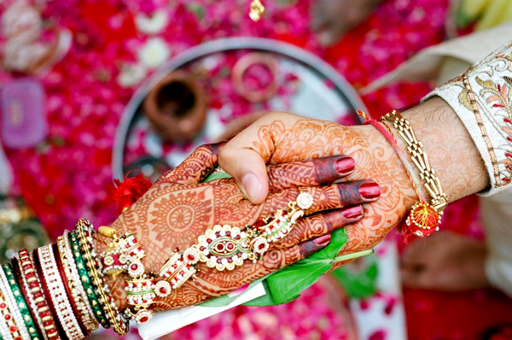
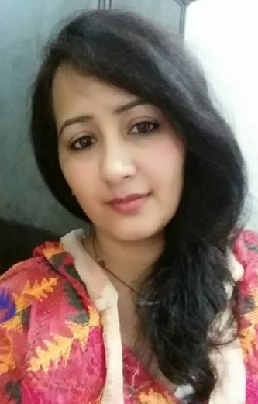
12G20
Hindu Punjabi, British Citizen
D.O.B.: 6/6/1996 Height: 5feet 4’’
Qualification: B Sc. - Mental Health Nursing
Currently working as a Project Co-ordinator - NHS
Hobbies: Reading, Music, Calligraphy, Photography
13G20
Hindu Punjabi, British Citizen
D.O.B.: 28/8/1989 Height: 5feet 4’’
Qualification: Post Graduate - Legal
Currently working as a Project Co-ordinator – NHSRegulatory Analyst
Hobbies: Football, Tennis, Cinema, Music, Gym, Swimming, Yoga, Eating Out
Looking for Liked minded individual, good family values, similar interests, good work – life balance
14G20
Hindu Punjabi, Based in India
D.O.B.: 4/2/1983 Height: 5feet
Qualification: BA - Media
Currently working as a Sub-Editor for a Newspaper
Hobbies: Cooking, watching movies, socialising with family & friends
Looking for a family oriented person who is caring and kind-hearted

Slide 27
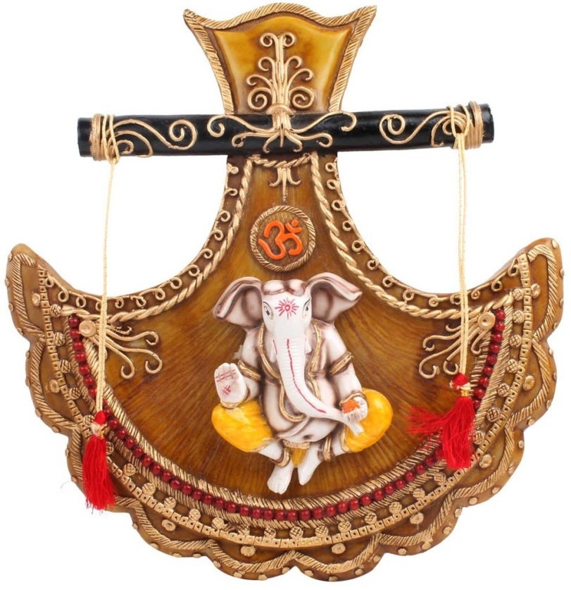
15G20
Hindu Brahmin, Indian Citizen based in UK on ICT Tier 2 visas
D.O.B.: 5/3/1992 Height: 5feet 4’’
Qualification: BCA – Information Technologies
Currently working as a Software Engineer
Hobbies: Music & Drawing
Looking for some working in UK, friendly and supportive and who can guide my family as an elder son. I believe in God and expect the same from my better half.
16G20
Hindu Kamma/ Kshatriya, Indian Citizen based in UK on Tier 2 General visas
D.O.B.: 30/11/1989 Height: 5feet
Qualification: M Sc. – Artificial Intelligence
Currently working as a Data Scientist at an Oil and Gas firm
Hobbies: Drawing, cycling, listening to music
Looking for a professionally well-placed and compatible partner
17G20
Hindu Reddy, Indian Citizen based in UK on Tier 2 Work Permit
D.O.B.: 2nd May 1991 Height: 5feet2’’
Qualification: MBBS, MRCGP
Currently working as a GP Trainee first year
Hobbies: Painting, dancing, cinemas
Looking for a good family and someone with family settled in the UK, preferably doctor and Telugu, but open to others

Slide 28
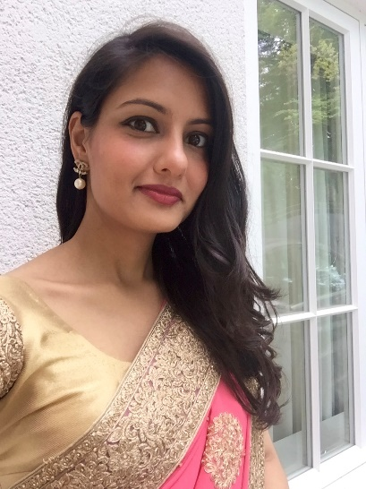
18G20
Hindu Malayalam, British Citizen
D.O.B.: 27th June 1991 Height: 5feet1’’
Qualification: MBChB, MRCP
Currently working a Medical Registrar ST3
Hobbies: Reading, baking, travelling, Music & Movies.
Looking for Professionals born and brought up in UK.
Religion / Cast no bar
19G20
Hindu Mudaliar, British Citizen
D.O.B.: 29th April 1978 Height: 5feet3’’
Qualification: MBA – Business, Marketing & Chemistry
Currently working in Marketing business
Hobbies: Sports, reading, keep fit classes, cooking, travelling and cinema
Looking for an adventurous, kind soul mate. Non-smoker, social drinker and educated (degree), non-vegetarian
20G20
Hindu Kshatria, British Citizen
D.O.B.: 26th May 1984 Height: 5feet2’’
Qualification: MBBS, MCGP, MS Management
Currently working as a General Practitioner – Healthcare Investor
Hobbies: Reading, hiking, socialising, meeting family, travelling and real estate
Looking for a smart, kind, fun, supportive man who is looking to build a future together

Slide 29
21G20
Hindu Kannada, British Citizen
D.O.B.: 22nd December 1995 Height: 5feet3’’
Qualification: Master’s in Engineering – Bio Medical
Currently working as a Research Analyst
Hobbies: Dancing, painting and interior decorating
Looking for a well educated professional Hindu, preferably vegetarian, UK Citizen

