Slide 1
BALAJI TEMPLE MATRIMONIAL SERVICES REGISTERED ASPIRANTS GROOMS

Slide 2
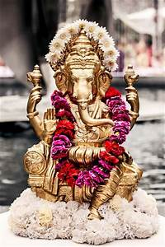
2022
01B22
Hindu Pillai, British Citizen
D.O.B.: 16/08/1978 Height: 5Feet 4’’
Mother Tongue: Tamil
Qualification: Msc Physiotherapy (Chemistry)
Hobbies: Travelling (East Asia), Hiking, Food, Cooking, Cycling, Swimming, Football, Computer Gaming, Movies, Writing, Home Improvement, Gardening.
02B22
Hindu Brahmin
D.O.B.: 02/04/1991 Height: 5Feet 4’’
Mother Tongue: Telugu
Qualification: MD(Interest Internal Medicine)/PhD(Biotech)
Hobbies: Hiking, Skiing, Reading, Outdoors, Cooking.
Looking for good values and culture.

Slide 3
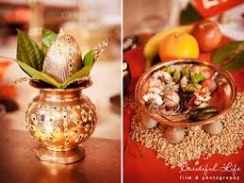
03B22
Hindu Brahmin, British Citizen (Divorced)
D.O.B.: 16/04/1984 Height: 5Feet 11’’
Mother Tongue: Hindi
Qualification: B.Eng (Hons)
Hobbies: Tennis, Hiking & Badminton.
04B22
Hindu Kshatriya Raju, British Citizen
D.O.B.: 21/05/1983 Height: 5Feet 11’’
Mother Tongue: Telugu
Qualification: MS & BE
Hobbies: Table-tennis, Chess, Cricket, Gym workouts/Weight training, Jogging/Walking/Running, Yoga/Meditation, Badminton.

Slide 4
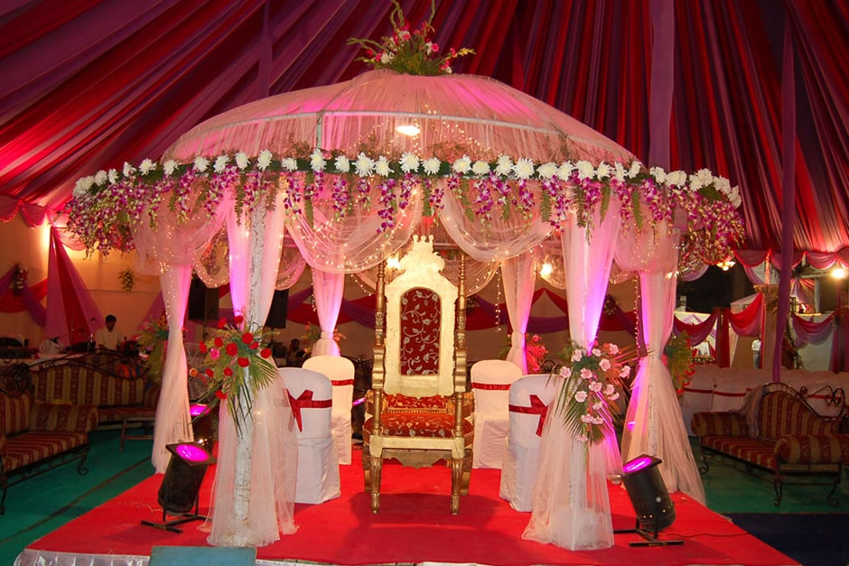
05B22
Hindu Khatri, British Citizen
D.O.B.: 29/10/1991 Height: 6Feet 2’’
Mother Tongue: English
Qualification: BSc/MSc
Hobbies: Football, Cricket, Formula 1, Reading, Cooking, Travelling.
Looking for Ideally someone who is Hindu Punjabi, British citizen, family oriented, educated professional (aged 27-31)
06B22
Hindu Naidu, British Citizen
D.O.B.: 07/08/1991 Height: 5Feet 11’’
Mother Tongue: Telugu
Qualification: B.Sc Hons
Hobbies: Cricket, Badminton.
Looking for Professional, family orientated.

Slide 5
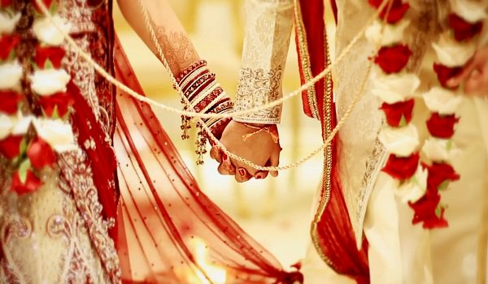
07B22
Hindu Mudaliar, British Citizen
D.O.B.: 07/06/1993 Height: 172cms
Mother Tongue: Tamil
Qualification: B.E (Aerospace Engineering), MSc (Space Technology)
Hobbies: Travelling, Gym, DIY, Reading.
Looking for Professional, with good family values,working in the United Kingdom, preferably a British Citizen.
08B22
Hindu, British Citizen
D.O.B.: 14/09/1991 Height: 5Feet 7’’
Mother Tongue: English
Qualification: PhD Genetics
Hobbies: Cricket, Tennis, Badminton, Board Games, Gardening, Socilising.

Slide 6
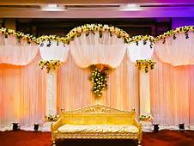
09B22
Hindu Brahmin, Indian Citizen
D.O.B.: 26/06/1990 Height: 5Feet 10’’
Mother Tongue: Telugu
Qualification: MSc IIT Madras
Hobbies: Reading.
Looking for a Brahmin girl ready to settle in Bangalore, India.
010B22
Hindu Goldsmith, British Citizen
D.O.B.: 10/12/1982 Height: 5Feet 8’’
Mother Tongue: Punjabi
Qualification: Trade – Gas Engineer Electrician
Hobbies: Reading Books, Travelling.
Looking for a Hindu Punjabi down to Earth Person.

Slide 7
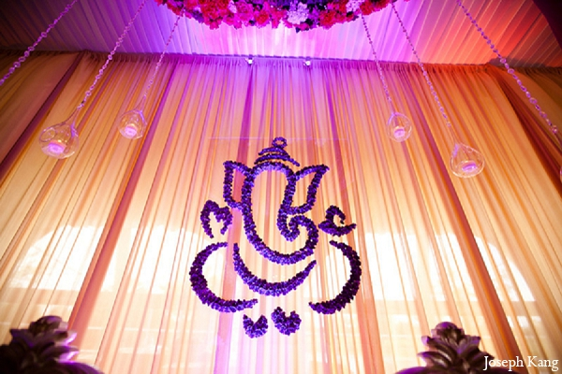
2021
01B21
Hindu Naickar (Kamma), British Citizen
D.O.B.: 18/12/1990, Height: 5feet 7’’
Mother Tongue: Marathi
Qualification: B.Sc, MBBS
Working with NHS in London
Hobbies: Badminton, Learning Languages, Listening to Music, Playing Guitar, Exploring new Places and Experiencing Culture & History
Looking for Medical Professional, Settled in UK, Mix of Traditional & Modern values, Non Smoker and Non Drinker.
02B21
Hindu Arya Vyshyas(Guptas/Shetty’s/Komati), Indian Citizen
D.O.B.: 14/04/1991 Height: 165 cms
Mother Tongue: Telugu
Qualification: Masters (Software Engineering)
Hobbies: Watching Movies, Learning New Skills.

Slide 8
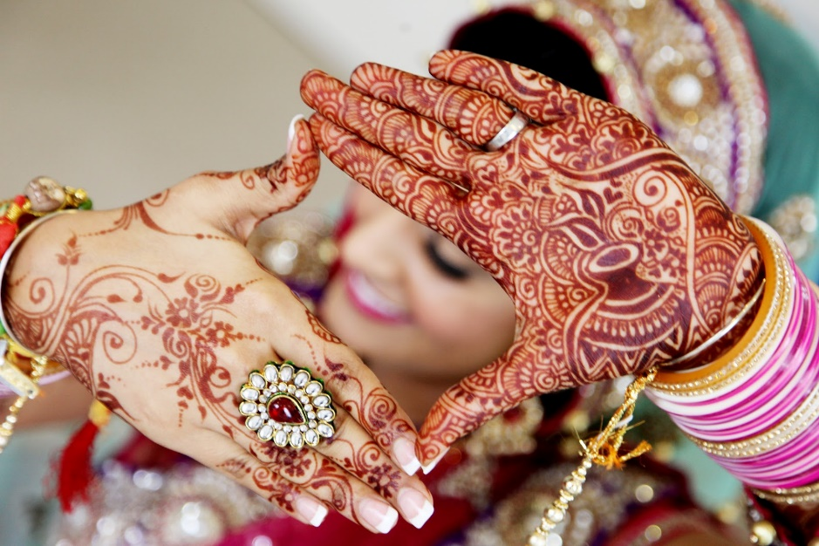
03B21
Hindu Brahmin, British Citizen
D.O.B.: 16/08/1980, Height: 5feet 8’’
Mother Tongue: English
Qualification: A Levels & GCSEs
Working as Loader/Packer
Hobbies: Walking, TV, Politics, News
Looking for kind natured, simple & homely future wife.
04B21
Hindu & Sikh, British Citizen
D.O.B.: 03/05/1994, Height: 5feet 5’’
Mother Tongue: Punjabi
Qualification: Bachelors Degree in Machanical Engineering
Working as Data Administrator

Slide 9
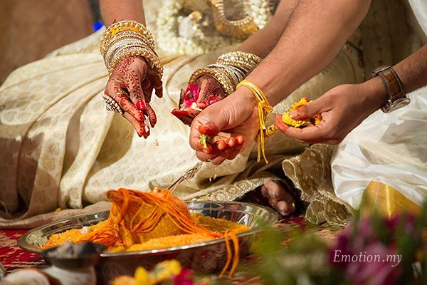
05B21
Hindu Padmashali
D.O.B.: 24/07/1993, Height: 5feet 8’’
Mother Tongue: Telugu
Qualification: B Tech
Working as Salesforce Consultant
Hobbies: Photography, Music, Watching Movies
Looking for decent family background and liberal values.
06B21
Hindu Brahmin, British And Canadian Dual Citizenship
D.O.B.: 17/12/1992, Height: 5feet 9’’
Mother Tongue: Telugu
Qualification: MBBS
Working as Doctor (Anaesthesiology first year post-graduate specialty training CT1)
Hobbies: Music, Nature, Badminton, Cycling and Movies
Looking for UK based professional Brahmin girl. Ideally UK citizen and/or raised in the West, but not essential.

Slide 10
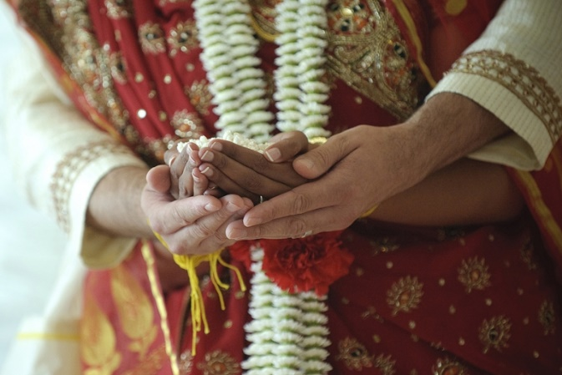
07B21
Hindu Girnara Soni, British Citizen
D.O.B.: 10/03/1988, Height: 5feet 9’’
Mother Tongue: Gujarati
Qualification: B Tech
Working as Business man
Looking for a vegetarian girl and family orientated.
08B21
Hindu Nai Brahmin, British Citizen
D.O.B.: 16/06/1992, Height: 5feet 5’’
Mother Tongue: Telugu
Qualification: MD, Specialty Trainee in GP
Working as Specialty Trainee in GP, NHS
Hobbies: Computers, Travel, Technology, Movies
Looking for preferably doctors, open to other professionals.

Slide 11
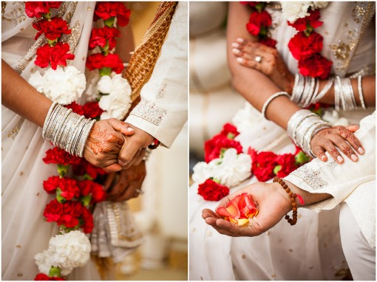
09B21
Hindu Karuneegar, British & Indian Citizen
D.O.B.: 18/08/1994, Height: 5feet 7’’
Mother Tongue: Tamil
Qualification: MS (Scientist), Specialization in Pharmacology
Working as Scientist
Hobbies: Reading, Cooking, Gym, Long Walks, Technology, Watching Movie
Looking for Hindu, Pure Vegetarian, Slim, Good Looking, Family Oriented, Employed Girls.
Brahmin, Karuneegars, Saiva Only need.

Slide 12
2020
01B20
Hindu Reddy, British Citizen
D.O.B.: 29/10/1976, Height: 5feet 6’’
Mother Tongue: Telugu
Qualification: MBBS
Working as an NHS Consultant
02B20
Hindu Dhawan, Indian Citizen
D.O.B.: 11/01/1987 Height: 5feet 4’’
Mother Tongue: Punjabi
Qualification: MA in Business Management
Hobbies: Listening to music, cinema, reading, walking
Looking for someone who is caring and understanding and who will be my companions for life.
03B20
Hindu Kannada Veerashiva, Indian Citizen based in UK on Tier 4 Visas
D.O.B.: 14/1/1991 Height: 6feet
Mother Tongue: Kannada
Qualification: BE – Civil, MS (UK) in Civil Engineering
Hobbies: Billiards, horse riding, gardening, landscaping, football
Looking for someone who is good looking and qualified

Slide 13
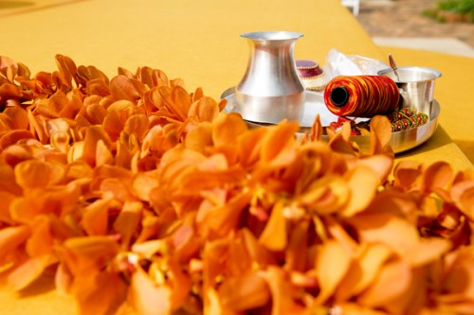
04B20
Hindu Khatri, British Citizen
D.O.B.: 28/6/1986 Height: 5feet6’’
Mother Tongue: English
Qualification: BE – Electronic Engineering
Currently self employed as a Software Designer
Hobbies: Family, exercise
05B20
Hindu Brahmin, Based in Switzerland
D.O.B.: 12/7/1978 Height: 5feet10’’
Mother Tongue: Tamil
Qualification: M Sc. Business Admin
Currently working as a CEO in WDS, Switzerland
Hobbies: Fitness/ Motor Boat driving
06B20
Hindu Brahmin, British Citizen
D.O.B.: 13/11/1992 Height: 5feet10’’
Mother Tongue: Punjabi
Qualification: M Sc. Engineering Business
Currently working as Europe Customer Manager – Rolls Royce
Hobbies: Playing sports, gym, Punjabi music, travelling, cooking, watching films, shopping, dining at nice places
Looking for someone who is educated, nice natured, modern, well-settled and wanting a serious relationship

Slide 14
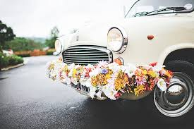
07B20
Hindu, British Citizen
D.O.B.: May 1986 Height: 5feet7’’
Mother Tongue: Hindi
Qualification: MRCGP – General Practice
Currently working as a General Practitioner
Hobbies: Watching films, reading, playing tennis, music, sports
Looking for a suitable match preferably doctor, dentist or a post graduate
08B20
Hindu Brahmin, British Citizen
D.O.B.: 30/9/1993
Mother Tongue: Hindi/ Punjabi
Qualification: MBCHB
Currently working for NHS (Hospital)
Hobbies: Sports, reading, travelling
09B20
Hindu, Divorced, Indian Citizen on Residence Permit
D.O.B.: 20/6/1981, Height: 5feet 9’’
Mother Tongue: Tamil
Qualification: M Sc. & PGCE (Teacher Training) Specialised in Engineering & Physics
Currently working in a Secondary School as a Science Teacher
Hobbies: Listening to music, watching films, playing badminton and travelling
Looking for a Hindu, well educated, family oriented, kind and broad minded individual

Slide 15
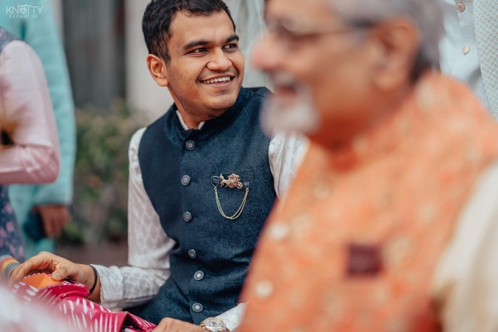
10B20
Hindu Marwadi, Indian Citizen based in Germany on Work Permit
D.O.B.: 19/12/1994, Height: 5feet 8’’
Mother Tongue: Hindi
Qualification: M Sc. In Investment Banking & Capital Markets
Currently working as an Associate DC Placement Advisors
Hobbies: Movies, comedy, meeting new people, travelling, running, cycling
Looking for a partner who would like travelling, explore hidden places around the world, honest and adaptable. Would like a spontaneous and an open-minded partner.
11B20
No Longer Available
12B20
Hindu Gharwali Brahmin, Indian Citizen based in Mumbai
D.O.B.: 3/9/1987, Height: 5feet 7’’
Mother Tongue: Hindi
Qualification: MBA – Consulting in Durham UK
Currently working in a Consumer Electronics Company
Hobbies: Travelling, reading, biking, listening to music, watching movies, eat and work
Looking for someone who is mature, well read, travelled, career oriented, likes to eat and travel and a bit accommodating with new people.

Slide 16
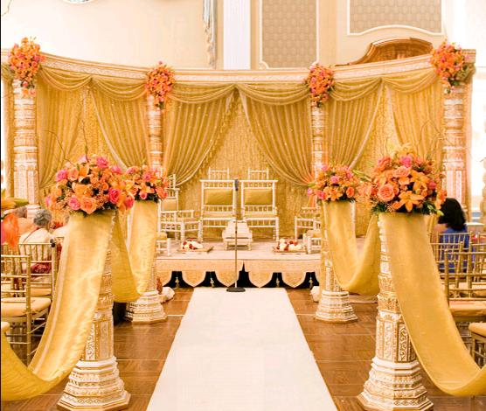
13B20
Hindu Khatri/ Brahmin, British Citizen
D.O.B.: 24/6/1978, Height: 6 feet
Mother Tongue: English
Qualification: PhD – Engineering & Chemistry
Currently working in University Professor in Chemical Engineering
Hobbies: Reading, travelling, playing sports, walking, cycling, learning about different cultures, cooking, gardening, DIY
Looking for a caring, kind-hearted and family-oriented person
14B20
Hindu Niyogi/ Brahmin, British Citizen
D.O.B.: 28/04/1995, Height: 5feet 11’’
Mother Tongue: Telugu
Qualification: Masters in Engineering – Aeronautical
Currently working in Leonardo Helicopters
Hobbies: Play Carnatic Violin, Biking, physical fitness
Looking for a vegetarian, professional, working in the UK
15B20
Hindu Punjabi/ Brahmin
D.O.B.: 15/7/1986, Height: 5 feet 8’’
Mother Tongue: English/ Punjabi
Qualification: Degree – Business Management
Currently working as a Senior Finance Manager in Bank
Hobbies: Gym, eating out, socialising, films family, cars
Looking for family oriented person

Slide 17
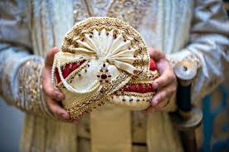
16B20
Kannada Brahmin, British Citizen currently based in Dubai
D.O.B.: 18/10/1993, Height: 6 feet
Mother Tongue: Kannada
Qualification: BE - Hons – Electrical/ Electronics
Currently working as an Engineer
Hobbies: Sports, Keep-fit, Music, Travel
Looking for a partner from professional background, height above 5feet 4’’, good looking from a decent family background with interest in similar hobbies.
17B20
Tamil Iyer, British Citizen
D.O.B.: 13/03/1997, Height: 5 feet 8’’
Mother Tongue: Tamil
Qualification: B Sc. – Hons - Optometry
Currently working as an Optometrist
Hobbies: Photography, Reading, Music, Travelling
Looking for a good looking professional, Hindu Brahmin, preferably South Indian vegetarian girl with good family background
18B20
Hindu Kamma, Indian Citizen
D.O.B.: 8/9/1981, Height: 5 feet 6’’
Mother Tongue: Telugu
Qualification: B Tech/ BE – Computer Science
Looking for an understanding girl settled in UK or India

Slide 18
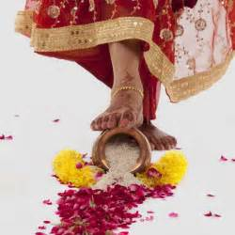
19B20
Hindu Kamma, British Citizen
D.O.B.: 26/1/1993, Height: 6 feet 1’’
Mother Tongue: Telugu
Qualification: LLB
Working as a Consultant in Executive Search
Hobbies: travelling, playing guitar, listening to music, reading books
Looking for a UK based girl, age 23 to 26 years, height 5ft 4’’ and above, working full/ part time, caste no bars.

Slide 19
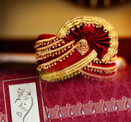
2019
01B19
Hindu Parihar, UK Citizen
D.O.B.: 8/2/1985, Height: 5feet 8’’
Mother Tongue: Hindi
Qualification: B Tech
Hobbies: Various interests like travelling, sports, music
Looking for an Indian girl
02B19
Hindu Gujarati, Indian Citizen based in UK on Tier 4 Student Visas
D.O.B.: 17/10/1995, Height: 5feet 11’’
Qualification: M Sc. Advanced Mechanical Engineering
Hobbies: Travelling, Reading
Looking for Hindu Girl
03B19
Hindu Punjabi, British Citizen
D.O.B.: 14/09/1991, Height: 5feet 6’’
Qualification: Phd Bio-infomatics
Working in Senior Data Processing
Hobbies: Reading, Gym, Travelling
Looking for a well educated and settled family girl

Slide 20
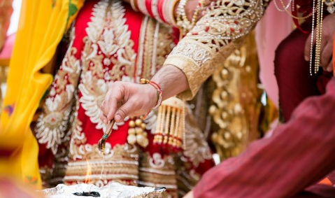
04B19
Hindu Arora, Indian Citizen based in UK on Tier 2 visas
D.O.B.: 21/07/1988 Height: 5feet 10’’
Qualification: MBBS (India), DNA Anaesthesia
Working as a dual trainee in Intensive care Medical and Anaesthesia
Hobbies: Hiking, Badminton
Looking for a well educated, Professional, Good looking girl, Settled or willing to settle in UK
05B19
Hindu Punjabi, British Citizen, Divorced
D.O.B.: 05/11/1975 Height: 5feet 9’’
Qualification: M Com, B Ed PGDCA part qualified ACCA UK
Working as a Supporting Actor, will discuss the whole situation in person
Hobbies: Acting
Looking for a suitable general category female, Horoscope aspect must match
06B19
Hindu Punjabi Khatri, Caste No Bars
D.O.B.: 28/03/1977 Height: 6feet
Qualification: Fellowship of Royal College of Surgeons - Neurosurgeon
Looking for a suitable match between age of 33 to 38 years, preferably 5feet4’’ and above

Slide 21
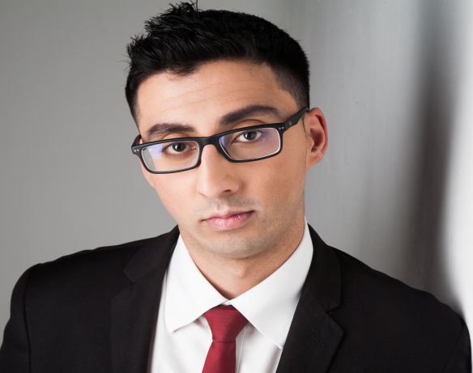
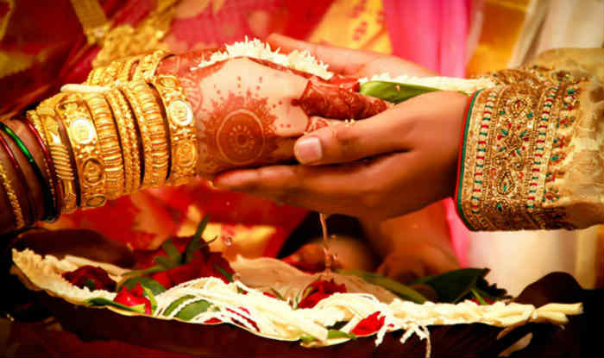
07B19
Hindu/ Sikh Khatri (Caste No Bar), British Citizen
D.O.B.: 16/05/1990 Height: 5feet 10’’
Qualification: M Sc. Specialised in Actuary
Working in Actuary
Hobbies: Gym, Keep fit, travel, chess, board games
Looking for a professional, educated girl, non-vegetarian, British Citizen
08B19
Tamil Hindu, Based in UK with France Citizenship
D.O.B.: 18/09/1988 Height: 5feet 8’’
Qualification: B.E., MBA – Operations & Supply chain management
Working as a planner or Analyst – Managerial Position
Hobbies: Music, Movies
Looking for a Tamil bride, 5 to 5feet 5 inches, educated in same caste
09B19
Hindu Gujarati, British Citizen
D.O.B.: 06/08/1986, Height: 5 feet 9’’
Qualification: A Level – Computer IT
Working in Banking Finance
Hobbies: Gym, meet friends and go cinema
Looking for preferably someone who is based in UK and Gujarati (but do not mind)
10B19
Hindu Telugu, British Citizen
D.O.B.: 24/11/1984, Height: 5feet 7’’
Qualifications: Masters in Physics, Specialised in Computer
Currently working as a Software & Team Manager
Hobbies: Playing drums, playing football, Badminton
Looking for someone with UK Citizenship, able to work around London or closer, would consider any one working in UK

Slide 22
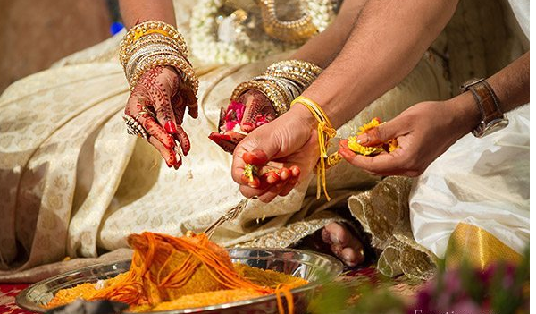
11B19
Punjabi, British Citizen, Divorced
D.O.B.: 25/10/1963, Height: 5feet 5’’
Qualifications: C S.E (in English & Maths)
Currently working as a Sales Manager in ASN, Handsworth
Hobbies: Gym, watching sports
Looking for a life partner (Caste no Bars)
12B19
Hindu Telugu, British Citizen
D.O.B.: 14/2/1993, Height: 5feet 7’’
Qualifications: M.A. in Social Policy with Social & Political Science
Currently working as a Policy Officer in Scottish Government
Hobbies: Travelling
13B19
Punjabi, Permanently based in UK
D.O.B.: 25/03/1978, Height: 5feet 6’’
Qualifications: Diploma Airport – Operations – Health & Social Care
Currently working as a Support Force Worker – Voyage Care
Hobbies: Enjoy gym, cooking, movies, like playing pool or snooker, computers
Looking for a understanding, loving partner who wants to settle down. Someone who can be soul friends with and share a new live with

Slide 23
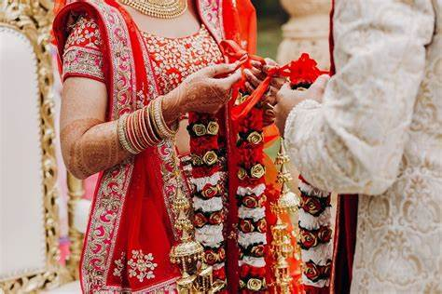
14B19
Hindu, Tamil, Indian based in Chennai (Was based in UK on Tier 2 ICT in the past)
D.O.B.: 14/06/1986, Height: 5feet 7’’
Qualifications: BE in ECE
Currently working as a Software Architect
Hobbies: Film Making, Watching Movies
Looking for a lovable and caring partner
15B19
Hindu Telugu, British Citizen
D.O.B.: 23/1/1985, DOB: 5feet 8’’
Qualifications: Masters in Hospitality Management
Currently working in Education Sector
Looking for a simple and well understanding match from a Telugu family
16B19
No longer available.

Slide 24
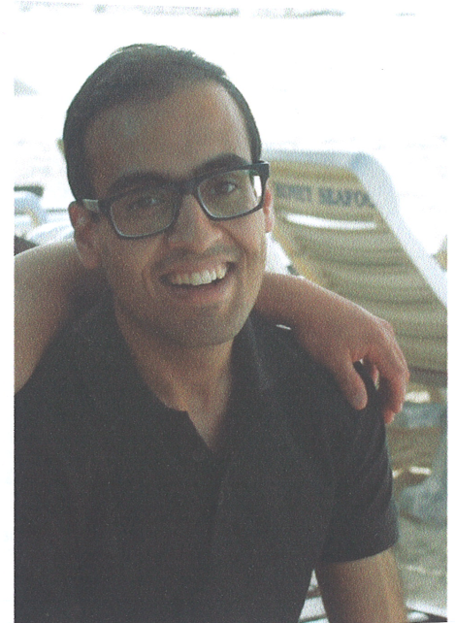
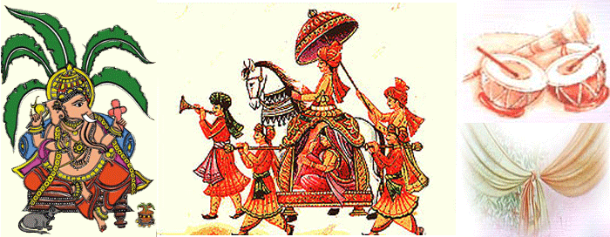
17B19
Hindu Punjabi Brahmin, British Citizen
D.O.B.: 28/03/1990, Height: 5feet 9’’
Qualifications: Bio Engineering, MB ChB
Currently working as a Doctor
Hobbies: Travelling, listening to music, meeting people
Looking for a friendly, warm and pleasant partner with good sense of humour.
18B19
Hindu Punjabi, British Citizen
D.O.B.: 13/08/1988, Height: 6feet 1’’
Qualifications: MENG – Engineering, Economics & Management – Oxford University
Founder of own successful finance technology company
Hobbies: Tennis, squash, gym, snooker, comedy, walking
Looking for a tall, good-looking, down to earth, well educated girl
19B19
No longer available

Slide 25
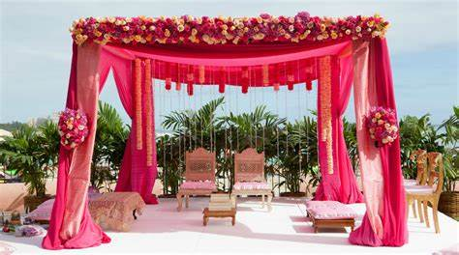
20B19
Hindu Tamil, Indian Citizen based in UK on Tier 2 ICT
D.O.B.: 17/7/1987, Height: 5feet 3’’
Qualifications: Bachelor on Engineering -ECE
Currently working as a Technical Lead in Wipro Limited
Hobbies: Reading books, swimming, weight lifting, surfing
Looking for an educated homely girl with good characters who valves Indian cultures, family and relationships
21B19
Hindu Punjabi, British Citizen
D.O.B.: 03/9/1988, Height: 6feet 1’’
Qualifications: B Sc. M. Sc. Audiology
Currently working as an audiologist
Hobbies: Meeting friends, reading, exploring new places
Looking for down to earth, like minded person
22B19
Hindu Baniya, Indian Citizen on Tourist Visas
D.O.B: 12/7/1983, Height: 5feet 8’’
Qualifications: MBA (University of Greenwich)
Currently self employed
Looking for a well-educated, homely professional

Slide 26
23B19
No longer available
24B19
Hindu Punjabi, British Citizen
D.O.B.: 21/1/1982, Height: 5feet 7’’
Qualifications: B Sc. (Optom)
Currently working as a Optician
Hobbies: Listening to music
Looking for a suitable qualified degree holder
25B19
Hindu Punjabi Brahmin, Divorced, British Citizen
D.O.B.: 19/4/1983, Height: 5feet 11’’
Qualifications: B Sc. (Chem), MBA
Currently working as a Managing Director
Hobbies: Fitness (Running, Gym, Hiking and Yoga), Meditation, Travelling
Looking for a like minded lady, kind hearted, good natured and looking to build a lifetime with her partner.

Slide 27
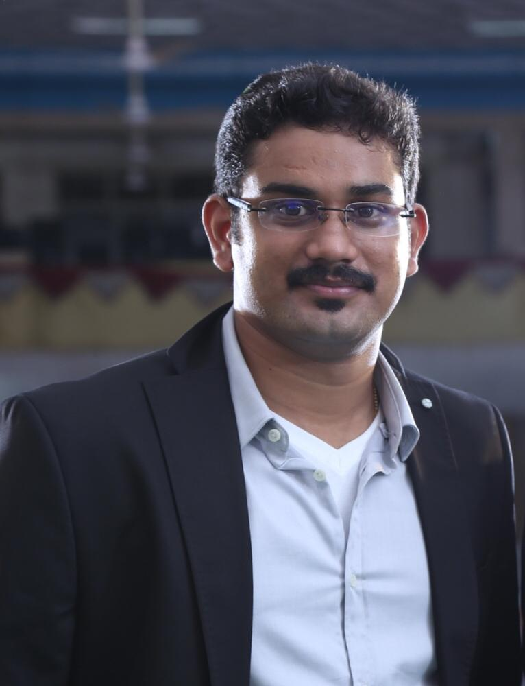
26B19
Hindu Punjabi Khatri, British Citizen
D.O.B.: 22/9/1986, Height: 6feet
Qualifications: B A Hons International – Business Management
Currently working as a Retail Manager
Hobbies: Gym, Eat out, Travel, Reading, Music
Looking for a partner with a mix a traditional, modern values, who can be a life partner
27B19
Hindu Punjabi Brahmin, British Citizen
D.O.B.: 17/09/1983, Height: 5feet 8’’
Currently working as a Bank Officer
Hobbies: Sports, Work Out
Looking for a family oriented, non-drinker
28B19
Tamil Hindu, Indian Citizen
D.O.B.: 16/4/1991, Height: 5feet 10’’
Qualification: B Tech – Electrical and Electronics Engineering
Currently working as Automation and CSV Engineer in Pharmaceutical
Hobbies: Music, exercise, exploring places, internet surfing and online learning
Looking a smart, good looking, well educated, good work experience, upper middle class bride who is willing to work in Ireland, preferable from 24 Manai telugu chettiar caste, other caste with suitable profile also accepted

Slide 28
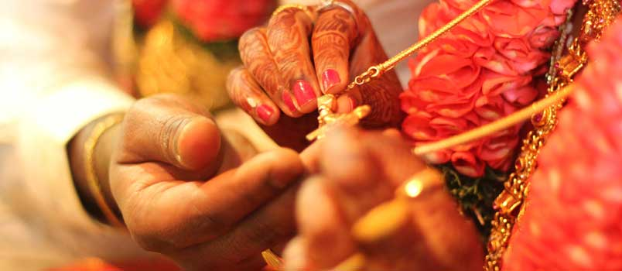
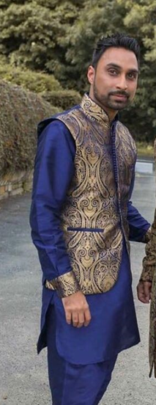
29B19
Hindu Punjabi, British Citizen
D.O.B.: 27/9/1985, Height: 6feet 2’’
Qualification: BA Hons – R.E & Philosophy
Currently working as a Pastoral Officer/ Mentor in Specialist Education
Hobbies: Bouldering, Guitar, Yoga, cinema, food, bowling, community service, spending time with family
Looking for a educated British girl, good nature, easy going, understanding and into fun things
30B19
Hindu , British Citizen
D.O.B.: 17/10/1972, Height: 5feet 6’’
Qualification: BA Hons – Business Finance
Currently self employed (Co-Director)
Hobbies: Cinema, restaurants, holidays, weekend breaks, jogging, days out, shopping, spending time with family
Looking for a nice simple genuine Hindu girl, nice personality, respect values, nice natured, caring, honest, from loving family background
31B19
Hindu Punjabi, British Citizen
D.O.B.: 2/11/1983, Height: 5feet 7’’
Qualification: BA Hons – Accounting & Finance
Currently self employed (Recruitment Agency)
Hobbies: Non – Vegetarian, non-smoker, occasional drinker, watching movies & documentaries, listening to music, socialising with friends and family, working out, enjoying a variety of cuisines, travelling worldwide.
Looking for an educated, easy going, homely, Indian cultured girl with family oriented values. Age up to 30 years, height up to 5 feet 4’’, Non-vegetarian and happy to settle in Newcastle upon Tyne

Slide 29
32B19
Hindu Sindhi, British Citizen
D.O.B.: 29/03/1980, Height: 5feet 8’’
Qualification: Master in E-Business + MBA - Internet Marketing International Business
Currently employed in Strategy & Transformation at American Express
Hobbies: Sport, Music, Travel
Looking for Vegetarian Hindu Girl
33B19
No Longer Available
34B19
Hindu – English, has knowledge about Kannada & Hindi/British Citizen living in London
D.O.B.: 2/3/1985, Height: 5 feet 11”
Qualification: Association of Chartered Certified Accountants – Economics/Accountancy
Present Occupation: Finance Director
Hobbies: Football, Travelling & Socialising with friends
Looking for British nationality, educated and working in London and in UK aged between 27-32 yrs

