Slide 1

BALAJI TEMPLE MATRIMONIAL SERVICES REGISTERED ASPIRANTS GROOMS

Slide 2
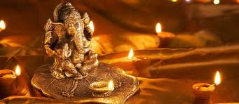
2024
01B24
Hindu Brahmin, British Citizen.
D.O.B.: 10/09/1995 Height: 5Feet 10’’
Mother Tongue: Punjabi.
Qualification: BA Finance with Accounting.
Currently working as a Asisstant Accountant.
Hobbies: Weight Training, Football.
02B24
Jain Shevtambar, Indian Citizen.
D.O.B.: 12/12/1978 Height: 5Feet 10’’
Mother Tongue: Hindi.
Qualification: Masters in Food Chain Management.
Currently is a Businessman.
I grew up in rich/affluent, nuclear family. Recently, I lost my beloved beautiful wife. I am fit and handsome and looking for same match – beautiful and an intelligent life partner who can love my 5 year daughter as I love.

Slide 3
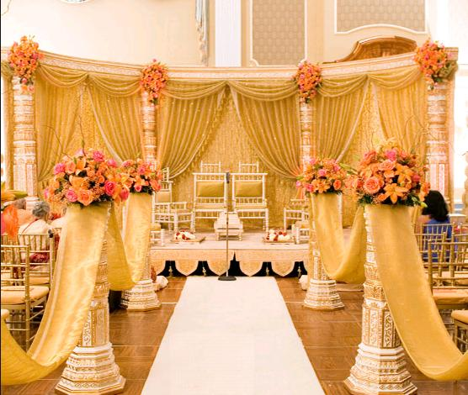
03B24
Hindu Balija, Indian Citizen.
D.O.B.: 10/12/1988 Height: 5Feet 6’’
Mother Tongue: Kannada.
Qualification: BBM, MBA, MSc.
Currently working as a Customer Service Associate.
Hobbies: Yoga, Meditation, Listening to Music, Travelling, Hiking, Cooking, Reading, Research on new business ideas.
Looking for a soulmate who can be my best friend for life. One who enjoys and cherishes every moment of life. She should be a creative and supportive person who is willing to build and explore our future together. I strongly believe in mutual understanding and interests, age, caste and marital status don’t matter to me.
04B24
Hindu Brahmin, UK Citizen, Divorced.
D.O.B.: 07/01/1981 Height: 5Feet 9’’
Mother Tongue: Kannada.
Qualification: B.E and MBA.
Currently working as Head of Delivery (Software Projects).
Hobbies: Badminton and Long Walks.
Looking for a hindu bride, strict vegetarian only.

Slide 4
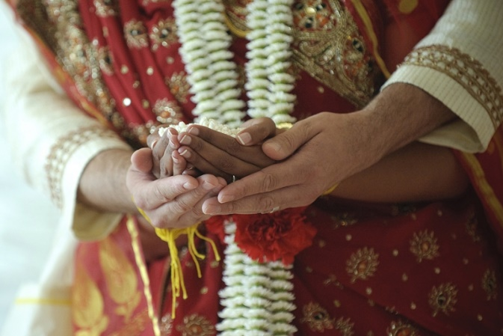
05B24
Hindu Brahmin, British Citizen.
D.O.B.: 27/01/1983 Height: 6Feet Divorced.
Mother Tongue: Kannada.
Qualification: MS.
Currently working as a Specialist in Software Engineering.
Hobbies: Sports (Badminton, Cricket), Trekking and Philanthropy.
Looking for a woman interested in pursuing whatever she wants and also interested in starting a family.
06B24
Hindu Arya Vysya, British Citizen.
D.O.B.: 07/03/1985 Height: 5Feet 3’’.
Mother Tongue: Kannada.
Qualification: B.Tech, Ph.D
Currently working as a Research Associate.
Hobbies: Web Development, Natural History, HAM Radio, Reading.
Looking for a vegetarian, unmarried, compassionate girl.
07B24
Hindu Brahmin, British Citizen.
D.O.B.: 02/03/1983 Height: 5Feet 10’’.
Mother Tongue: English.
Qualification: Ph.D
Currently working as a Lecturer.
Hobbies: Footboll, Driving, Travelling.
Looking for a girl with good personality and attractive behaviour.

Slide 5
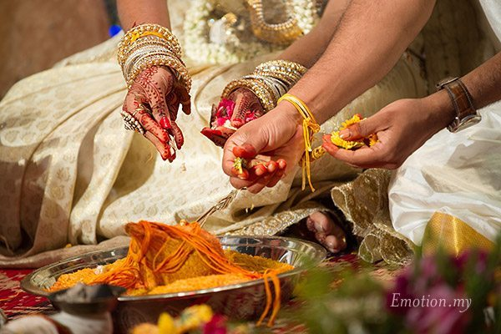
08B24
Hindu Baniya, British Citizen.
D.O.B.: 21/01/1982 Height: 5Feet 7’’.
Mother Tongue: Punjabi.
Qualification: BSc (Hons) PhD.
Currently working as an education lead for pharmaceutical company.
Hobbies: Sports, Reading, Travelling, family time, movies, music, walking.
Looking for a Hindu bride with family values, preferably never married.
09B24
Hindu Pillia, British Citizen.
D.O.B.: 19/12/1989 Height: 5Feet 6’’.
Mother Tongue: Tamil.
Qualification: CFA, BSc.
Currently working as a Director – Investment Banking.
Hobbies: Gym and Tennis.
Looking for a professional girl.
10B24
Hindu Yadava, United States of America Citizen.
D.O.B.: 23/03/1978 Height: 5Feet 9’’.
Qualification: Engineering.
Currently working as a Network Engineer.

Slide 6
11B24
Hindu Gowda, British Citizen.
D.O.B.: 29/07/1994 Height: 5Feet 9’’.
Mother Tongue: Konkani.
Qualification: B.Sc
Currently working technical consultant.
Hobbies: Gym, Cricket, Cycling, Cinema,Travelling.
Looking for a partner, preferably in Uk/India, 25 years.
12B24
Hindu Devanga Chettiar, British Citizen.
D.O.B.: 15/11/1998 Height: 173CM.
Mother Tongue: Kanadam/Tamil.
Qualification: MA, MSc Phsycology.
Currently working senior research executive.
Hobbies: Reading, Travelling worldwide, Cooking, Music, Swimming.
Looking for a preferably Hindu educated bride in Uk.

Slide 7
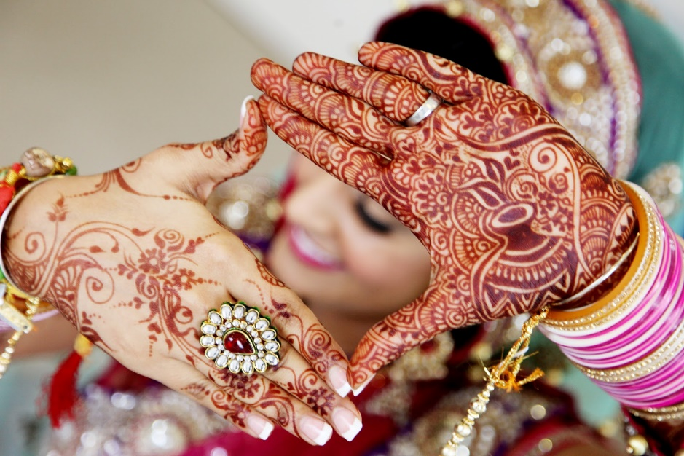
13B24
Hindu, Indian Citizen.
D.O.B.: 21/09/1978 Height: 5Feet 10’’.
Mother Tongue: Telugu.
Qualification: MBA, MSc Phsycology.
Currently working as head of sales.
Hobbies: Listening to Music, Travelling, Visiting new places, Cooking, Singing, Playing Cricket and Table Tennis.
Looking for a understanding and caring life partner who can lead a joyful, happy and contended life.
14B24
Hindu, Madiwala, Indian Citizen.
D.O.B.: 20/07/1983 Height: 5Feet 11’’.
Mother Tongue: Kannada.
Qualification: MSc.
Currently working as program manager.
Hobbies: Music, Travelling, Sports, Movies.
Looking for someone simple, loyal and family oriented girl who is respectful in every manner of life. Cast no bar. Someone who is serious to build a family together.

Slide 8

2023
01B23
No Longer Available
02B23
No Longer Available
03B23
Hindu Naiyakar, Indian Citizen
D.O.B.: 06/12/1989
Qualification: MSc
Currently working as an Engineer
Hobbies: Trekking, Cycling, Yoga, Badminton, Climbing.
Looking for a well educated and family oriented bride.
04B23
Hindu, Indian Citizen
D.O.B.: 15/05/1997 Height: 5Feet 7’’
Qualification: MSc
Looking for a good bride with good family values.

Slide 9
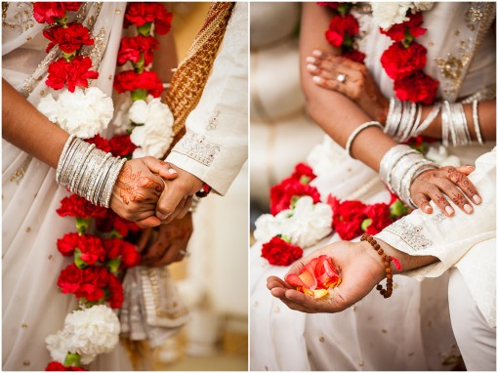
05B23
Hindu Reddy, Indian Citizen
D.O.B.: 21/03/1994 Height: 5Feet 11’’
Mother Tongue: Telugu
Qualification: Masters in Information Systems
Currently working as a Software Engineer (Support, Deployment, QA)
Hobbies: Gym, Cricket, Sleeping, Watching Movies.
Looking for Compatible, Understanding and Independent Women.
06B23
Hindu, British Citizen
D.O.B.: 20/06/1990 Height: 5Feet 5’’
Mother Tongue: English
Qualification: BSC/GDL
Currently working as a Corporate Solicitor
Hobbies: Outing, TV, Sport, Film, Food.
Looking for similar quality.
07B23
Hindu Brahmin, British Citizen
D.O.B.: 19/05/1990 Height: 6Feet 1’’
Mother Tongue: English
Qualification: Masters in Engineering in UK
Currently working as a Principal Technical Engineer.
Hobbies: Cricket, Dancing, Listening to Music, Cycling, Swimming, Travelling, Netflix, Gym and Outdoor activities.
Looking for an Independent, caring, fun loving and down to earth partner.

Slide 10
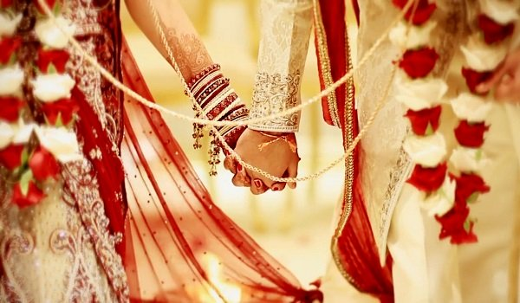
08B23
Hindu Kamma, British Citizen
D.O.B.: 23/01/1985 Height: 5Feet 8’’
Mother Tongue: Telugu
Qualification: MBA
Currently working as an Operations Manager.
Looking for a family orientated, educated professional, living in UK mostly.
09B23
Hindu Brahmin, Indian Citizen
D.O.B.: 21/09/1991 Height: 5Feet 9’’
Mother Tongue: Telugu
Qualification: B Tech (Computer Science)
Currently working as a Software Professional.
Hobbies: Reading, Watching Movies.
Looking for Telugu speaking Brahmin bride from a good family.
10B23
Hindu Kamma, British Citizen
D.O.B.: 29/08/1991 Height: 177Cms
Mother Tongue: Telugu
Qualification: MEng (Hons)
Currently working as a System Architect.
Hobbies: Badminton, Cycling, Photography.
Looking for professionally qualified bride from Hindu family who lives and works in the UK.

Slide 11
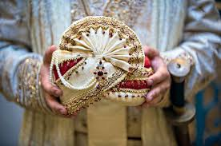
11B23
Hindu Naidu, French Citizen
D.O.B.: 23/10/1983 Height: 5Feet 10’’ Divorced
Mother Tongue: Telugu
Qualification: MBA
Currently working as a EMEA Sales Leader, Hitachi Ltd.
Hobbies: Playing Bansuri, Travelling, Cooking, Fitness and Reading.
Looking for mature and understanding partner located in the UK or willing to shift to UK, ideally engaged in a profession. I have a 7 year old Son who lives with my ex wife in India. I have parental obligations to visit him twice a year. Looking for a partner who understands this.
12B23
Hindu Vellalar, British Citizen
D.O.B.: 18/09/1995 Height: 5Feet 10’’
Mother Tongue: Tamil (Srilankan)
Qualification: M.Sc Astrophysics and Computer.
Currently working as a Solution Architect in IT.
Hobbies: Playing Badminton, Cycling, Gym and Compture Games.
Looking for a professionally qualified and family orientated bride.

Slide 12
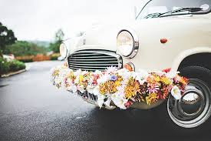
13B23
Hindu Sehdev, British Citizen
D.O.B.: 26/03/1972 Height: 5Feet 11’’
Mother Tongue: English/Hindi
Qualification: MB.ch.B/ Surgeon
Currently working as a Medical Doctor GP.
Hobbies: Watching Educational TV programme, Reading and Gym.
Looking for a suitable sincere/co-operative life partner from Hindu Family.
14B23
Hindu Jain, Indian Citizen
D.O.B.: 01/07/1988 Height: 6Feet - 183cm
Mother Tongue: Marathi
Qualification: MBBS, MD, DrNB cardiology
Currently working as a Senior Clinical Fellow at NHS.
Hobbies: Art, History, Trekkingelling, Music, Adventure, Travelling.
Looking for an open minded, liberal with good family values.
15B23
Hindu Kayasth, British Citizen
D.O.B.: 20/03/1988 Height: 5Feet 8’’
Mother Tongue: Hindi
Qualification: MBch, MSc, BSc
Currently working as a Doctor.
Hobbies: Reading, Music, Travelling, Cinema, Badminton.
Looking for a career driven partner, with strong family values, non smoker, ideally from UK or willing to settle in UK.

Slide 13
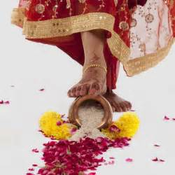
16B23
No Longer Available
17B23
Hindu Saiva Pillai, British Citizen
D.O.B.: 21/12/1974 Height: 6Feet 3’’
Mother Tongue: Tamil.
Qualification: Diploma.Mechanical Engg, B.Sc, P.G.D.BusinessAdminstration.
Currently working as Sales Manager Finance.
Hobbies: Watching Movies, Playing Cricket, Travelling, Music, Harakrishna.
Looking for Hindu, Good family background, willing to adjust and settle in UK.
18B23
Hindu Balija, American Citizen
D.O.B.: 22/04/1982
Mother Tongue: Telugu.
Qualification: B.Tech.
Currently working in Life Sciences Strategy and Analytics, Deloitte.
Hobbies: Fitness, Running, Hiking, Sports, Cooking, Arts & Photography, Outreach Activities.
Looking for Someone with similar interests, Physically active and outgoing. Value Traditions and respectful to elders & extended family. Must be jovial in nature.

Slide 14
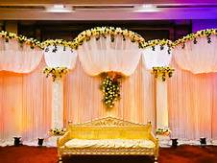
19B23
Hindu Jatav, Indian Citizen
D.O.B.: 17/09/1988 Height: 5Feet 6’’
Mother Tongue: English/Hindi.
Qualification: M.C.A.
Currently working as Lead Software Engineer.
Hobbies: Photography, Travel, Driving, Music.
Looking for Never Married Girl.
20B23
No Longer Available
21B23
No Longer Available
22B23
Hindu, British Citizen
D.O.B.: 30/08/1988 Height: 5feet 10’’
Qualification: MBBS, FRCS
Currently working as a Doctor
Hobbies: Sports, Photography, Reading, Travelling.
Looking for a like minded individual who wants to build a family together.

Slide 15
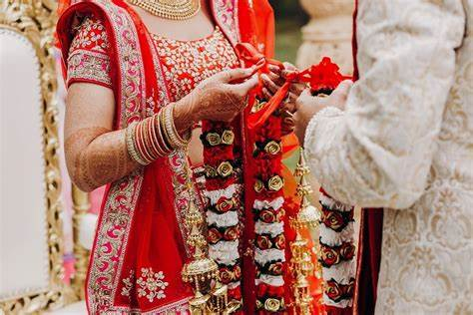
23B23
Hindu Kamma, British Citizen
D.O.B.: 23/06/1973 Height: 167CM Divorced
Qualification: B.E Mechanical
Currently working as an IT Management Professonal.
Hobbies: Reading Books, Watching Movies, Travel, etc.
Looking for a simple and understanding person.
24B23
Hindu Devanga Chettiar, British Citizen
D.O.B.: 23/07/1987 Height: 5Feet 9’’
Qualification: BSc, MA, Acca
Currently working as a Manager, PWC.
Hobbies: Reading, Cycling, Travelling, Watching Movies, Documentries.
Looking for a good looking, understanding, friendly, outgoing.
25B23
Hindu, British Citizen
D.O.B.: 24/10/1993 Height: 6Feet
Qualification: Meng Chemical Engineering
Currently working as a Lead Test Engineer.
Hobbies: Programming, Reading, Travelling, Cricket.
Looking for a best friend in my wife. An understanding partner.

Slide 16
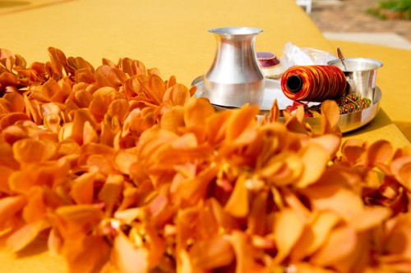
26B23
Hindu Iyer, British Citizen
D.O.B.: 10/07/1997 Height: 5Feet 10’’
Qualification: B.Eng PHD.
Currently working as a Structural Dynamicist Ministry of Defence.
Hobbies: Badminton, Computer Games, Investments.
Looking for a Indian Tamil Brahmin girl, professionally qualified and working. (Vegetarian, No-Drinking/Smoking).
27B23
Hindu Nadar, Indian Citizen
D.O.B.: 25/02/1988 Height: 178CM
Qualification: Bachelor of Engineering
Currently working in Centrica.
Hobbies: Badminton.
28B23
Hindu, British Citizen
D.O.B.: 27/05/1985 Height: 6Feet 2’’
Qualification: BA (Honors) PG Dip Computer Science.
Currently working as Digital Marketing Executive.
Hobbies: Travelling, Walking, Movies.

Slide 17
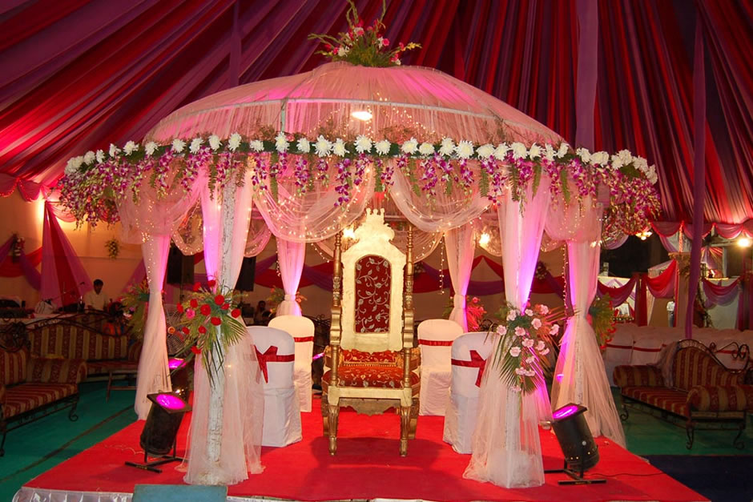
29B23
Hindu Khandayat, Indian Citizen
D.O.B.: 24/04/1984 Height: 161CM
Qualification: MBA
Currently working as Product Manager.
Hobbies: Watching Movies & Web series, Traveling, Cooking.
Looking for an educated, understanding, open minded, empathetic, one who belives in mutual respect and equal partnership. Cast no bar.
30B23
Hindu Brahmin, British Citizen
D.O.B.: 02/06/1996
Qualification: Diploma in Journalism
Currently working as Data Editor.
Hobbies: Running, Sport, Artwork through Chalk Pastels and pencil.
Looking for a Brahmin, vegetarian, well educated and working, good family background, born 1996 or after.
31B23
Hindu Brahmin, British Citizen
D.O.B.: 26/11/1994 Height: 6Feet 3’’
Qualification: BSC Computer Science
Currently working as a Banker.
Hobbies: Technology, Travelling, Swimming, Badminton, Current Affairs, Reading, Architecture and Art.
Looking for a kind, family and commitment orientated, similar values and born in UK.

Slide 18
32B23
Hindu Kayastha, British Citizen
D.O.B.: 29/04/1992 Height: 173CM
Qualification: Graduate in Aerospace Engineering.
Currently is working as Associate Director.
Hobbies: Hiking, Outdoor activites, Reading, Listening to Music, Sport.
Looking for a professional in IT Sector, Financial Sector, Doctor.
33B23
Hindu, Indian Citizen
D.O.B.: 13/10/1992 Height: 5Feet 11’’
Qualification: B.E, MSc.
Currently working as AI Developer in Autonomous Vehicles.
Hobbies: Badminton, Music, Movies, Travel.

Slide 19
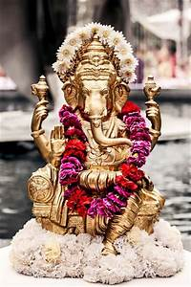
2022
01B22
Hindu Pillai, British Citizen
D.O.B.: 16/08/1978 Height: 5Feet 4’’
Mother Tongue: Tamil
Qualification: Msc Physiotherapy (Chemistry)
Hobbies: Travelling (East Asia), Hiking, Food, Cooking, Cycling, Swimming, Football, Computer Gaming, Movies, Writing, Home Improvement, Gardening.
02B22
Hindu Brahmin
D.O.B.: 02/04/1991 Height: 5Feet 4’’
Mother Tongue: Telugu
Qualification: MD(Interest Internal Medicine)/PhD(Biotech)
Hobbies: Hiking, Skiing, Reading, Outdoors, Cooking.
Looking for good values and culture.
03B22
Hindu Brahmin, British Citizen (Divorced)
D.O.B.: 16/04/1984 Height: 5Feet 11’’
Mother Tongue: Hindi
Qualification: B.Eng (Hons)
Hobbies: Tennis, Hiking & Badminton.

Slide 20
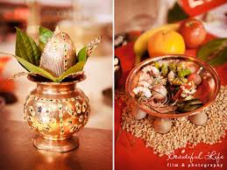
04B22
Hindu Kshatriya Raju, British Citizen
D.O.B.: 21/05/1983 Height: 5Feet 11’’
Mother Tongue: Telugu
Qualification: MS & BE
Hobbies: Table-tennis, Chess, Cricket, Gym workouts/Weight training, Jogging/Walking/Running, Yoga/Meditation, Badminton.
05B22
Hindu Khatri, British Citizen
D.O.B.: 29/10/1991 Height: 6Feet 2’’
Mother Tongue: English
Qualification: BSc/MSc
Hobbies: Football, Cricket, Formula 1, Reading, Cooking, Travelling.
Looking for Ideally someone who is Hindu Punjabi, British citizen, family oriented, educated professional (aged 27-31)
06B22
Hindu Naidu, British Citizen
D.O.B.: 07/08/1991 Height: 5Feet 11’’
Mother Tongue: Telugu
Qualification: B.Sc Hons
Hobbies: Cricket, Badminton.
Looking for Professional, family orientated.

Slide 21

07B22
Hindu Mudaliar, British Citizen
D.O.B.: 07/06/1993 Height: 172cms
Mother Tongue: Tamil
Qualification: B.E (Aerospace Engineering), MSc (Space Technology)
Hobbies: Travelling, Gym, DIY, Reading.
Looking for Professional, with good family values,working in the United Kingdom, preferably a British Citizen.
08B22
Hindu, British Citizen
D.O.B.: 14/09/1991 Height: 5Feet 7’’
Mother Tongue: English
Qualification: PhD Genetics
Hobbies: Cricket, Tennis, Badminton, Board Games, Gardening, Socilising.
09B22
Hindu Brahmin, Indian Citizen
D.O.B.: 26/06/1990 Height: 5Feet 10’’
Mother Tongue: Telugu
Qualification: MSc IIT Madras
Hobbies: Reading.
Looking for a Brahmin girl ready to settle in Bangalore, India.

Slide 22
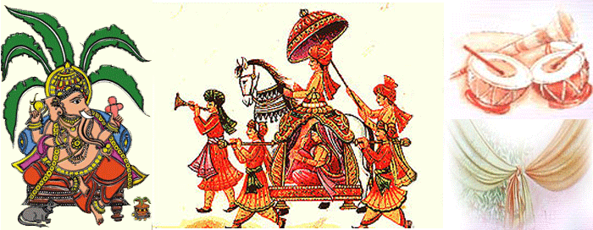
10B22
Hindu Goldsmith, British Citizen
D.O.B.: 10/12/1982 Height: 5Feet 8’’
Mother Tongue: Punjabi
Qualification: Trade – Gas Engineer Electrician
Hobbies: Reading Books, Travelling.
Looking for a Hindu Punjabi down to Earth Person.
11B22
Hindu Devanga Chettiar, British Citizen
D.O.B.: 28/08/1994 Height: 5Feet 11’’
Mother Tongue: Kannada
Qualification: M.ENG(UK), MBA (USA)
Working as Investment Banking Associate, USA
Hobbies: Cricket, Running, Hiking, Climbing.
Looking for a Hindu, Preferably Kannada/Tamil Professional Girl Settled in UK or USA, Family Oriented, Kind and Broad Minded Individual .
12B22
Hindu Brahmin, Indian Citizen
D.O.B.: 21/03/1993 Height: 180cm
Mother Tongue: Hindi, Marwari
Qualification: B.Tech Mechanical
Working as Risk Consultant
Hobbies: Reading Books.
Looking for someone who can be around me, talk to me and especially have love for Indian Culture. One who is ready to understand and follow my culture.

Slide 23
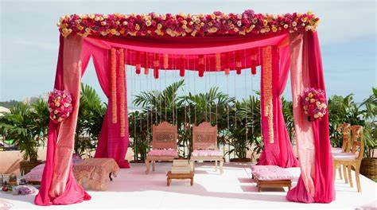
13B22
Hindu Brahmin, British Citizen
D.O.B.: 13/04/1993 Height: 5Feet 7’’
Mother Tongue: Kannada
Qualification: BA
Working in Banking
Hobbies: Reading, Listening to Music, Travelling, Watching movies, Gym, Cricket.
Looking for British Citizen, who is Hindu and is able to work in or around London. Family oriented, educated professional (aged 25-29) who is friendly, warm with a good sense of humour and likes travelling.
14B22
Hindu Naidu, Indian Citizen
D.O.B.: 19/10/1991 Height: 5Feet 11’’
Mother Tongue: Telugu
Qualification: BE
Working in Solutions Architect In Cognizant UK
Hobbies: Music, Travelling.
Looking for partner to journey through rest of the life with Indian Culture & values. Preferably from Naidu, open to others.

Slide 24
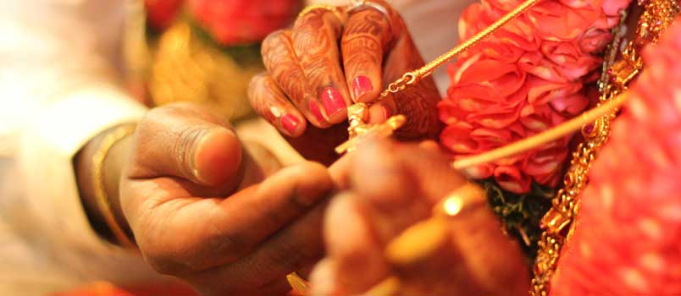
15B22
Hindu Vysyas, Indian Citizen
D.O.B.: 10/12/1991 Height: 5Feet 11’’
Mother Tongue: Kannada and Telugu
Qualification: ME., MSc
Working as Electronics Engineer
Hobbies: Playing Batminton, Blogging on Quora.
Looking for well educated, kind hearted girl from a decent family, who can be my wife and best friend for life. Preferably, Telugu/Kannada speaking, vegetarian, non-drinker and non-smoker and belives in God.
16B22
Hindu Brahmin, Indian Citizen
D.O.B.: 14/04/1990 Height: 5Feet 11’’
Mother Tongue: Telugu
Divorced
Qualification: B.Tech, M.S.
Working as Software Engineer
Hobbies: Listening to Music, Reading, Photography, Travelling, Hikes, Going to Parks and Museums.
Looking for a life partner who is understanding, caring, well-educated and family-oriented. Should be non-smoker and non-drinker. Must be living in the UK currently and willing to settle here.

Slide 25
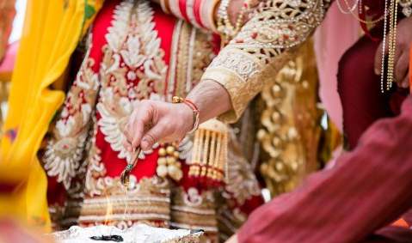
17B22
No Longer Available

Slide 26
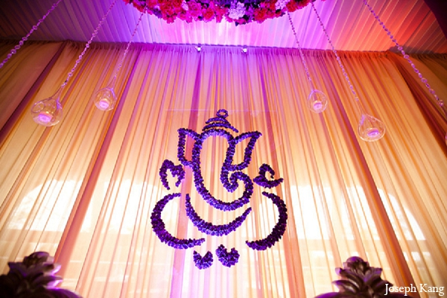
2021
01B21
Hindu Naickar (Kamma), British Citizen
D.O.B.: 18/12/1990, Height: 5feet 7’’
Mother Tongue: Marathi
Qualification: B.Sc, MBBS
Working with NHS in London
Hobbies: Badminton, Learning Languages, Listening to Music, Playing Guitar, Exploring new Places and Experiencing Culture & History
Looking for Medical Professional, Settled in UK, Mix of Traditional & Modern values, Non Smoker and Non Drinker.
02B21
Hindu Arya Vyshyas(Guptas/Shetty’s/Komati), Indian Citizen
D.O.B.: 14/04/1991 Height: 165 cms
Mother Tongue: Telugu
Qualification: Masters (Software Engineering)
Hobbies: Watching Movies, Learning New Skills.

Slide 27
03B21
Hindu Brahmin, British Citizen
D.O.B.: 16/08/1980, Height: 5feet 8’’
Mother Tongue: English
Qualification: A Levels & GCSEs
Working as Loader/Packer
Hobbies: Walking, TV, Politics, News
Looking for kind natured, simple & homely future wife.
04B21
Hindu & Sikh, British Citizen
D.O.B.: 03/05/1994, Height: 5feet 5’’
Mother Tongue: Punjabi
Qualification: Bachelors Degree in Machanical Engineering
Working as Data Administrator
05B21
Hindu Padmashali
D.O.B.: 24/07/1993, Height: 5feet 8’’
Mother Tongue: Telugu
Qualification: B Tech
Working as Salesforce Consultant
Hobbies: Photography, Music, Watching Movies
Looking for decent family background and liberal values.

Slide 28
06B21
No Longer Available
07B21
Hindu Girnara Soni, British Citizen
D.O.B.: 10/03/1988, Height: 5feet 9’’
Mother Tongue: Gujarati
Qualification: B Tech
Working as Business man
Looking for a vegetarian girl and family orientated.
08B21
Hindu Nai Brahmin, British Citizen
D.O.B.: 16/06/1992, Height: 5feet 5’’
Mother Tongue: Telugu
Qualification: MD, Specialty Trainee in GP
Working as Specialty Trainee in GP, NHS
Hobbies: Computers, Travel, Technology, Movies
Looking for preferably doctors, open to other professionals.

Slide 29
09B21
Hindu Karuneegar, British & Indian Citizen
D.O.B.: 18/08/1994, Height: 5feet 7’’
Mother Tongue: Tamil
Qualification: MS (Scientist), Specialization in Pharmacology
Working as Scientist
Hobbies: Reading, Cooking, Gym, Long Walks, Technology, Watching Movie
Looking for Hindu, Pure Vegetarian, Slim, Good Looking, Family Oriented, Employed Girls.
Brahmin, Karuneegars, Saiva Only need.

